Slide 1
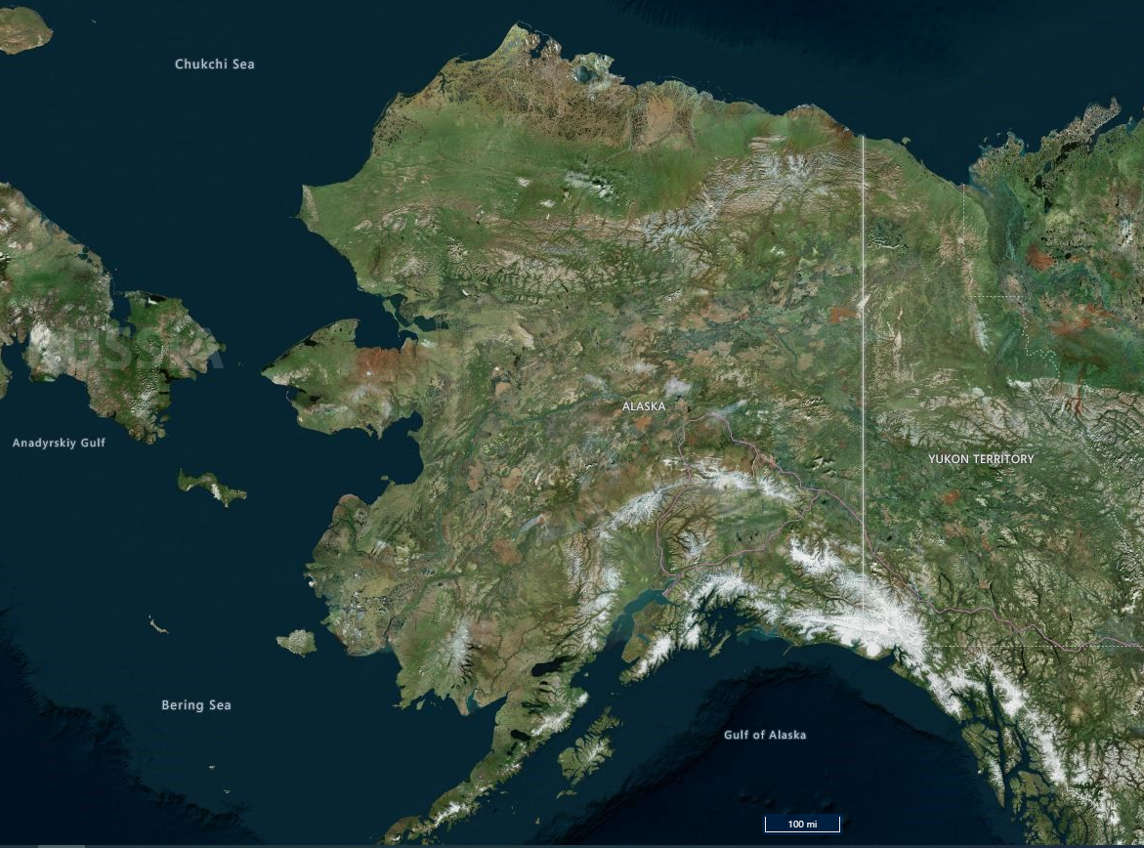
ALASKA’S ORPHAN WELLS
Shaviovik Unit 1
Shaviovik Unit 1
Gubik Unit 1
Gubik Unit 1
Eureka 1
Chickaloon 1
Eureka 1
Chickaloon 1
Rosetta 1, 2, 3, 4
Rosetta 1, 2, 3, 4
Middle Lk Unit 1A
Middle Lk Unit 1A
Alaska Gulf 1
Alaska Gulf 1
Chilkat No. 25
Chilkat No. 25
Sullivan Phillips 1
Sullivan Phillips 1
Key
On State, Native,
or Private Lands:
Eureka 1
Eureka 1
AOGCC September 14, 2022
Illustration Source: AK DNR, Alaska Mapper, Bing Hybrid Base Map

Slide 2
ALASKA’S ORPHAN WELLS
Key
On State, Native,
or Private Lands:
AOGCC September 14, 2022
Illustration Source: AK DNR, Alaska Mapper, Bing Hybrid Base Map

Slide 3
ALASKA’S ORPHAN WELLS
Key
On State, Native,
or Private Lands:
On Federal Lands:
AOGCC January 18, 2022
Illustration Source: AK DNR, Alaska Mapper, Bing Hybrid Base Map

Slide 4
ALASKA’S ORPHAN WELLS
Shaviovik Unit 1
Shaviovik Unit 1
Gubik Unit 1
Gubik Unit 1
Eureka 1
Chickaloon 1
Eureka 1
Chickaloon 1
Rosetta 1, 2, 3, 4
Rosetta 1, 2, 3, 4
Middle Lk Unit 1A
Middle Lk Unit 1A
Alaska Gulf 1
Alaska Gulf 1
Chilkat No. 25
Key
Chilkat No. 25
Sullivan Phillips 1
Sullivan Phillips 1
On State, Native,
or Private Lands:
Eureka 1
Alaska 1
Eureka 1
Finnegan 1
On Federal Lands:
Lee 1 (?)
Alaska 1
AOGCC January 18, 2022
Illustration Source: AK DNR, Alaska Mapper, Bing Hybrid Base Map

