Slide 1
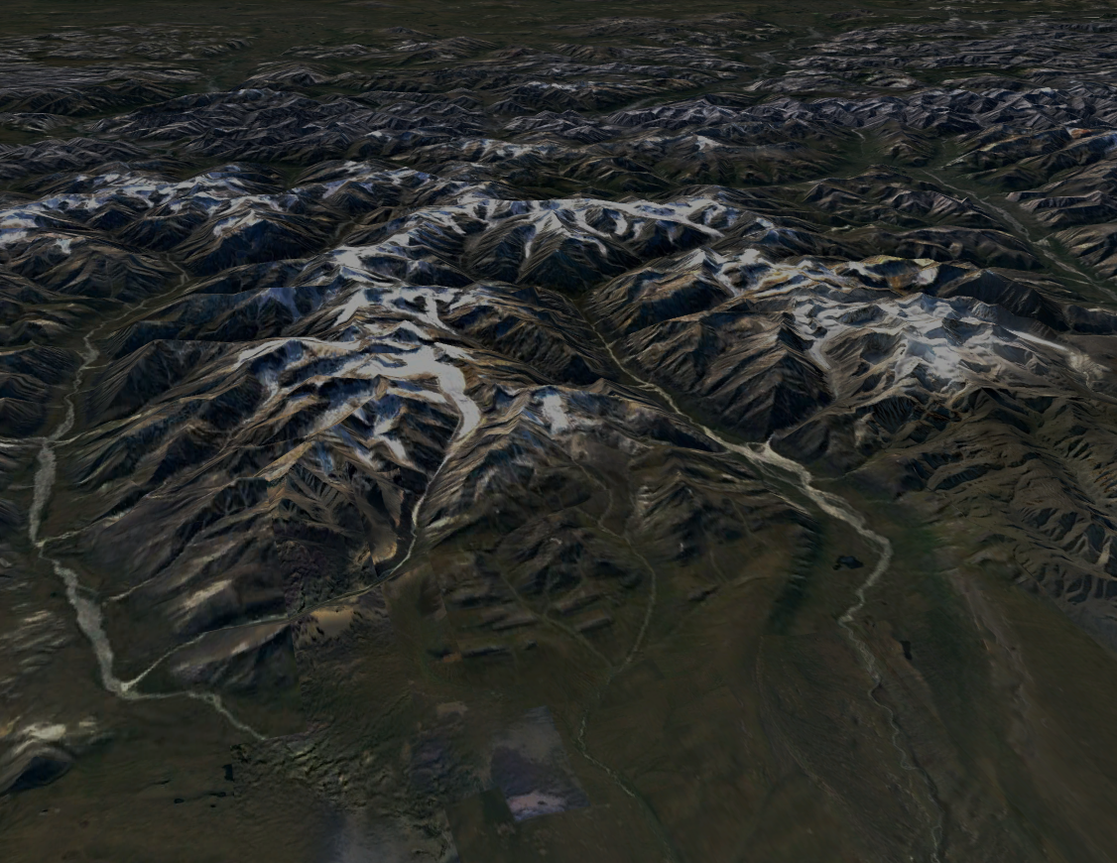
Alaska Oil and Gas Conservation Commission
Orphan Wells RFP Pre-Proposal Presentation
November 9, 2022
The meeting will start promptly at 1:05PM
Please mute all cell phones

Slide 2
Tips for participation
ONLINE: To “Raise Hand” go to the “Reactions”​
button on the bottom of your computer screen.​
ONLINE: On a mobile device, you may find the​
“Reactions” button by clicking the three dots next​ to participant.
to the “Participants”​ ON PHONE: To Raise Your Hand in the meeting​ when you’re on the phone, press star (*) 9

Slide 3
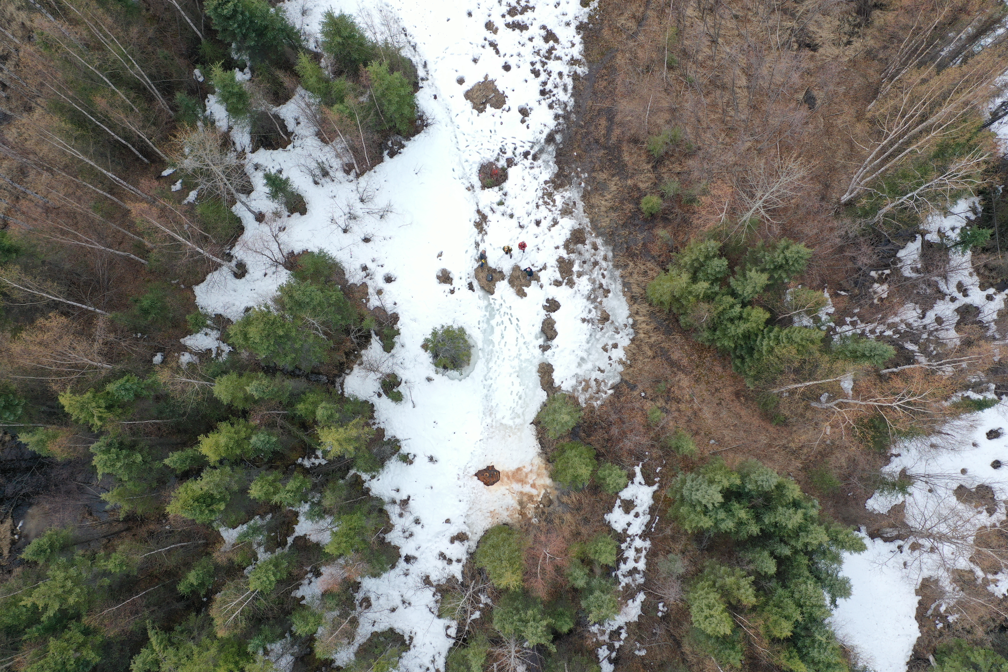
AOGCC Orphan Wells RFP
Alaska Department of Transportation, on behalf of the AOGCC, has issued a Request for Proposal (RFP) for a Construction Management/General Contractor (CMGC) contract to manage the Orphan Wells Program on State and Private lands in Alaska.
Proposal Deadline is November 30, 2022.
Link to the RFP:
https://www.bidx.com/ak/proposal?contid=RSA1039366CMGC
Note that “Attachment A” is located at the above website as an addendum.

Slide 4
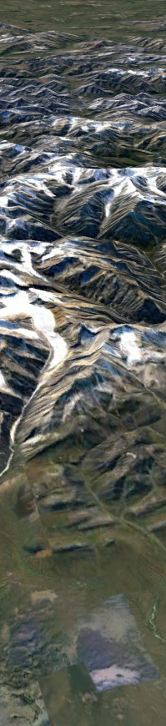
Additional information
Additional Orphan Wells Project information is located on the AOGCC website:
https://www.commerce.alaska.gov/web/aogcc/OrphanWellsGrant.aspx
  Contractor Outreach Meeting Presentation 9/22/22, slide pack and recorded meeting.
  Orphan Wells Initial Project Grant Notice of Award, includes federal requirements tied to the Grant.
  List of known or suspected Orphan Wells on state and private land in Alaska.

Slide 5
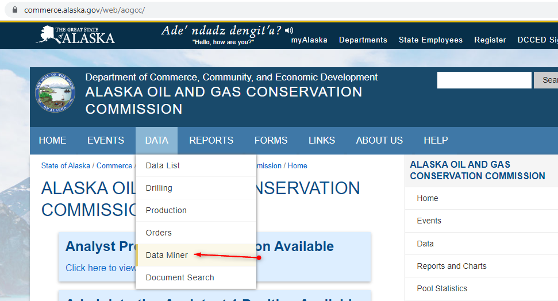
Additional information
Information specific to the wells can be accessed from the AOGCC website home page Data tab, Data Miner button:
https://www.commerce.alaska.gov/web/aogcc/OrphanWellsGrant.aspx

Slide 6
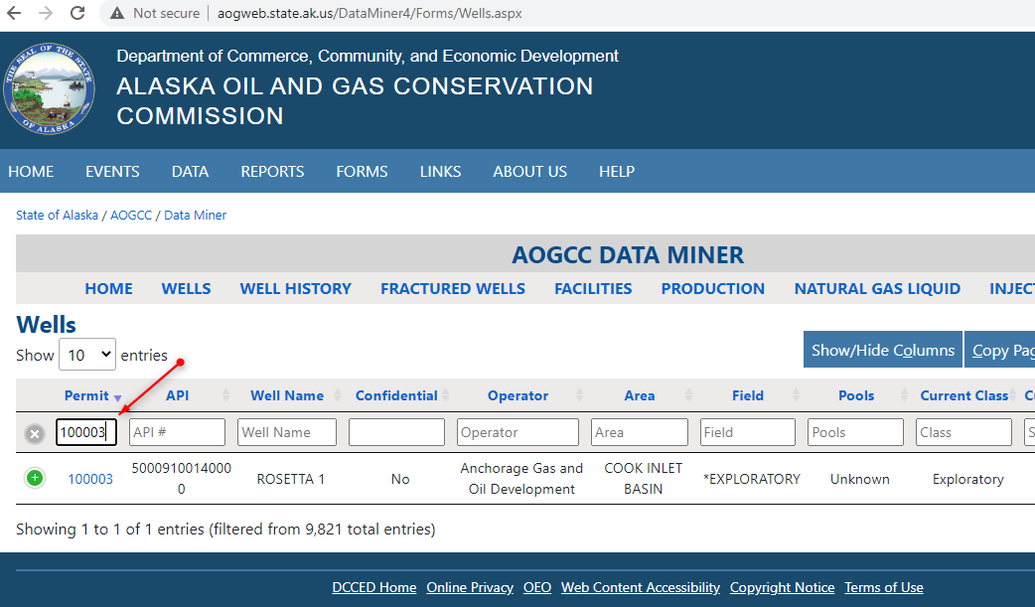
Additional information
From Data Miner, Click on “Wells” to reach the searchable well history. Access it directly at the following site: http://aogweb.state.ak.us/DataMiner4/Forms/Wells.aspx
Type the Permit To Drill number (no hyphen) into the Permit box to find the record.

Slide 7
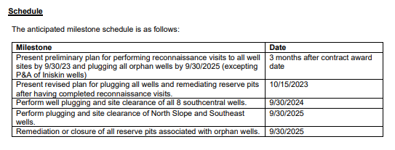
Schedule and Milestones
From Appendix B, Proposed Statement of Services, Page 2:
Provides flexibility to work in optimum season – winter or summer.
Expectation is that work will begin on site preparation ond/or plugging in 2023.

Slide 8
RFP submittal
Instructions for submitting proposals are included in the RFP.
Questions should be directed to the Contracts Point of Contacts (POCs) listed below.
  Pam Lord, 907-451-5299, pam.lord@alaska.gov
  Barbie Tanner, 907-451-3057, barbara.tanner@alaska.gov

Slide 9
Questions?
How can we help you
provide the best proposal to AOGCC?
ONLINE: To “Raise Hand” go to the “Reactions” button on the bottom of your computer screen.
ONLINE: On a mobile device, you may find the “Reactions” button by clicking the three dots next to the “Participants”
ON PHONE: To Raise Your Hand in the meeting when you’re on the phone, press star (*) 9

