Slide 1
Collaborative Community Planning for Resilient Alaska Communities
Sally Russell Cox, Alaska Division of Community and Regional Affairs  Northwest Interagency Partnership for Sustainable Communities Leadership Meeting  February 19, 2015

Slide 2
Outline
Brief Background
    Impacts of climate change on Alaska
    Timeline of state efforts on climate change
  State Programs and Projects
      Alaska Climate Change Impact Mitigation Program
      Mertarvik Strategic Management Plan
      Alaska Community Coastal Protection Project
  Critical Community Decision-Making Points throughout Process

Slide 3
Impacts of Climate Change on Alaska
Alaska is often referred to as the “canary in the coal mine” for climate change. As the only state in the nation with an Arctic region, the impacts of a changing climate are already evident.

Slide 4
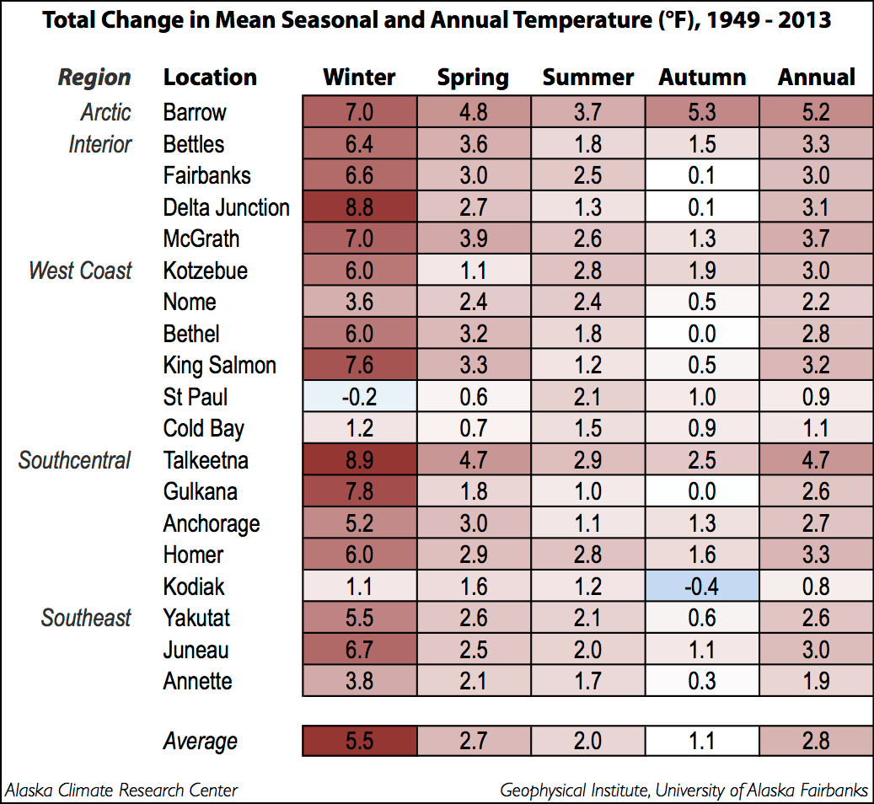
Impacts of Climate Change on Alaska
Over the past 60 years, Alaska has warmed more than twice as rapidly as the rest of the United States, with state-wide average annual air temperature increasing by nearly 3°F and average winter temperature by 5.5°F, with substantial year-to-year and regional variability.

Slide 5
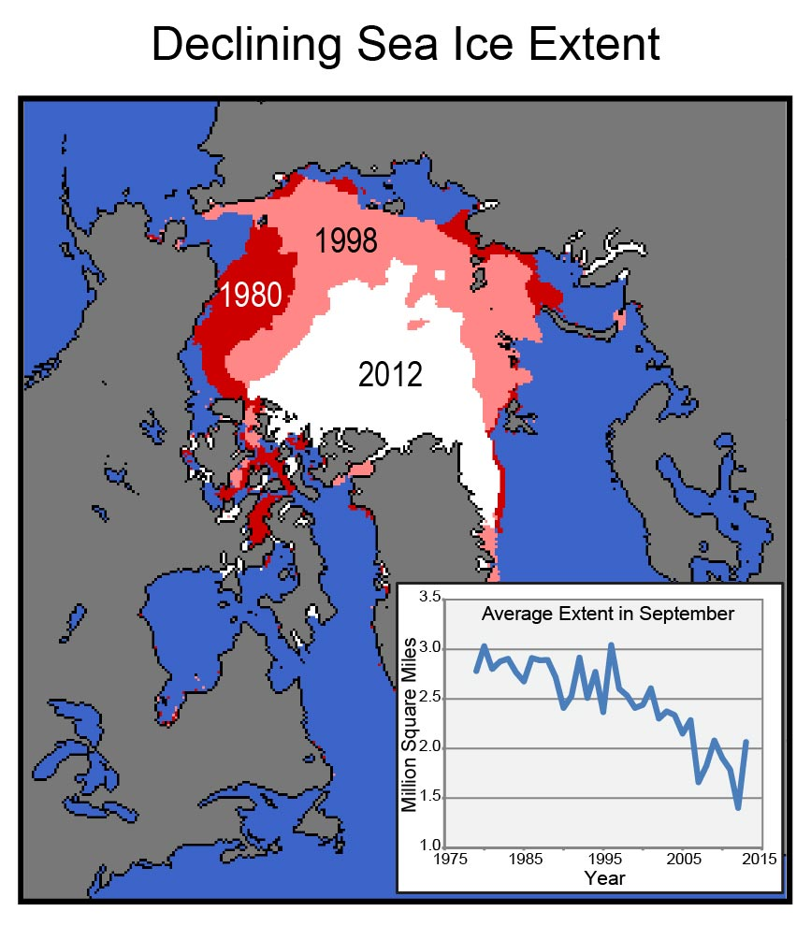
Reduction in Arctic Sea Ice
The extent and thickness of arctic sea ice has decreased significantly since 1979.
In the past, this ice has provided a “buffer” to the impacts of sea storms on coastal communities.
Figure source: NSIDC 2012; Data from Fetterer et al. 2013

Slide 6
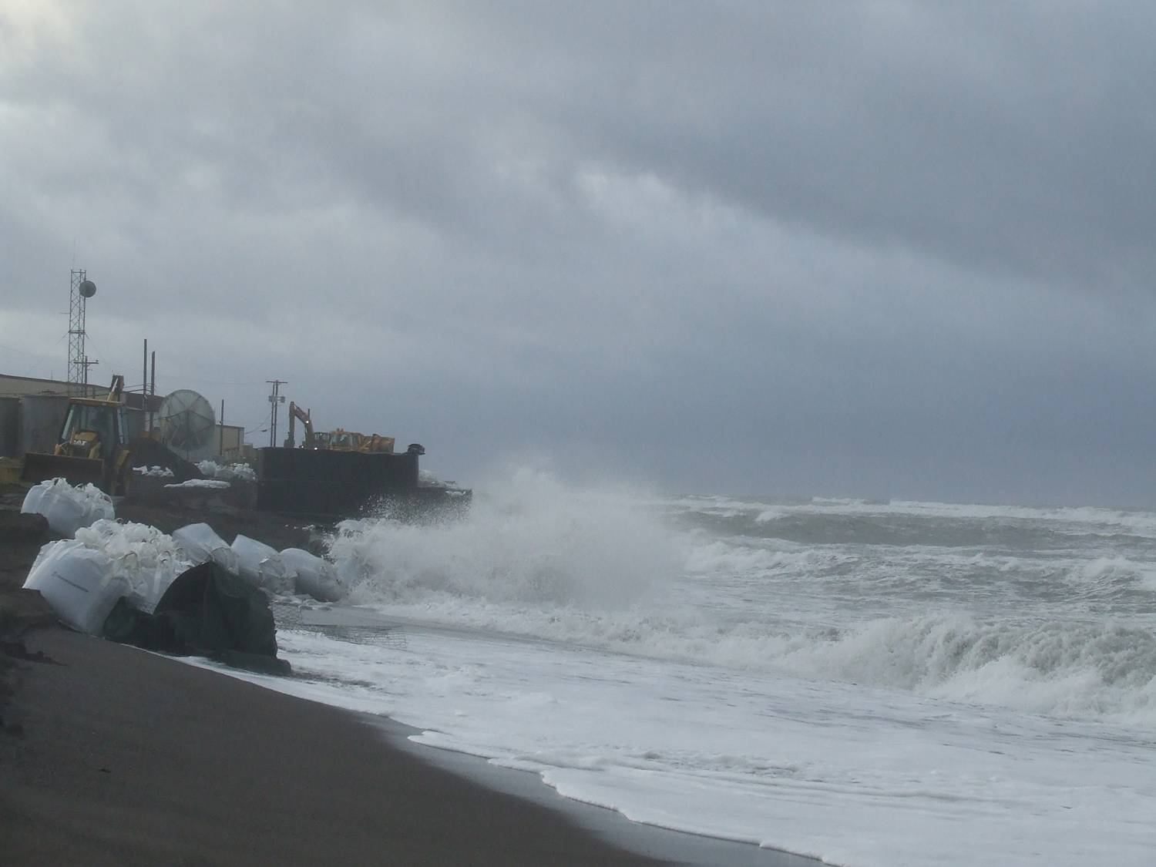
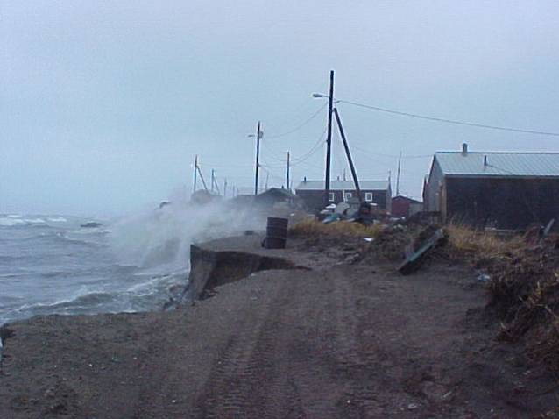
Reduction in Arctic Sea Ice
As a result, coastal communities are much more vulnerable to the impacts of coastal sea storms and related storm surges, flooding and erosion.
Kivalina
Shishmaref

Slide 7
Alaska Federally-Declared Disasters, 1953-2014
Date | Disaster # | Incident Description
1/23/2014 | 4162 | Severe Storms, Straight-line Winds, and Flooding
1/16/2014 | 4161 | Flooding
6/25/2013 | 4122 | Flooding
11/27/2012 | 4094 | Severe Storm, Straight-line winds, Flooding, and Landslides
2/2/2012 | 4054 | Severe Storm
12/22/2011 | 4050 | Severe Winter Storms and Flooding
6/10/2011 | 1992 | Ice Jam and Flooding
12/18/2009 | 1865 | Severe Storms, Flooding, Mudslides, and Rockslides
6/11/2009 | 1843 | Flooding and Ice Jams
9/26/2008 | 1796 | Severe Storms, Flooding, Landslides, and Mudslides
12/8/2006 | 1669 | Severe Storms, Flooding, Landslides, and Mudslides
10/27/2006 | 1666 | Fire
10/16/2006 | 1663 | Severe Storms, Flooding, Landslides, and Mudslides
8/4/2006 | 1657 | Snow Melt and Ice Jam Flooding
12/9/2005 | 1618 | Severe Fall Storm, Tidal Surges, and Flooding
3/14/2005 | 1584 | Severe Winter Storm
11/15/2004 | 1571 | Severe Winter Storm, Tidal Surges and Flooding
4/26/2003 | 1461 | Winter Storm
12/4/2002 | 1445 | Winter Storms
11/8/2002 | 1440 | Earthquake
6/26/2002 | 1423 | Flooding
2/17/2000 | 1316 | Winter Storms and Avalanches
Date | Disaster # | Incident Description
6/7/1996 | 1119 | Wildfires
10/13/1995 | 1072 | Severe Storm, Flooding
9/13/1994 | 1039 | Severe Storm, Flooding
5/30/1991 | 909 | Heavy Snow, Ice Jams, Flooding
6/10/1989 | 832 | Flooding
5/10/1989 | 826 | Severe Freezing
3/11/1988 | 813 | Fire
10/27/1986 | 781 | Coastal Storm, High Winds, Waves
10/27/1986 | 782 | Severe Storms, Flooding
12/18/1975 | 493 | Fire, Freezing
11/14/1974 | 452 | Severe Storms, Flooding
6/24/1974 | 444 | Freeze in Spawning Areas of Red Salmon
11/7/1973 | 408 | Heavy Rains, Flooding
12/19/1969 | 281 | Heavy Rains, Landslide
8/17/1967 | 230 | Severe Storms, Flooding
3/28/1964 | 168 | Earthquake
12/22/1955 | 46 | Severe Hardship to Salmon Industry
11/10/1954 | 31 | Severe Hardship to Salmon Industry
10/30/1953 | 13 | Severe Hardship to Salmon Industry
Source: https://www.fema.gov/disasters/grid/state-tribal-government/86?field_disaster_type_term_tid_1=All&order=field_disaster_declaration_date&sort=desc

Slide 9
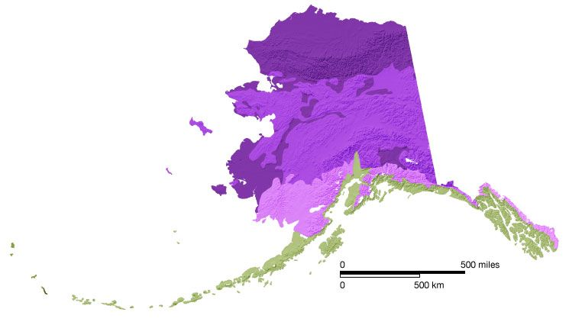
Thawing Permafrost
80% of land in Alaska is underlain by permafrost.
Permafrost near Alaska’s Arctic coast has warmed 4°F - 5°F at 65 foot depth since the late 1970s and 6°F to 8°F at 3.3 foot depth since the mid-1980s.
Source: National Snow & Ice Data Center
Thaw is already occurring in interior and southern Alaska, where permafrost temperatures are near the thaw point.

Slide 10
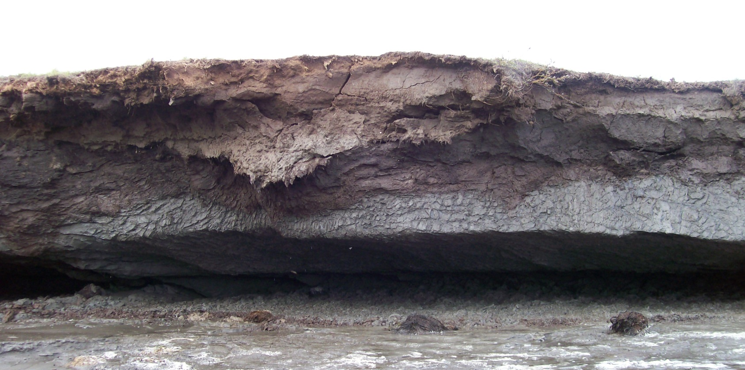
Thawing Permafrost
Ice - rich permafrost layer thaws when exposed to warmer river/sea water, leaving a “shelf” with no support.

Slide 11
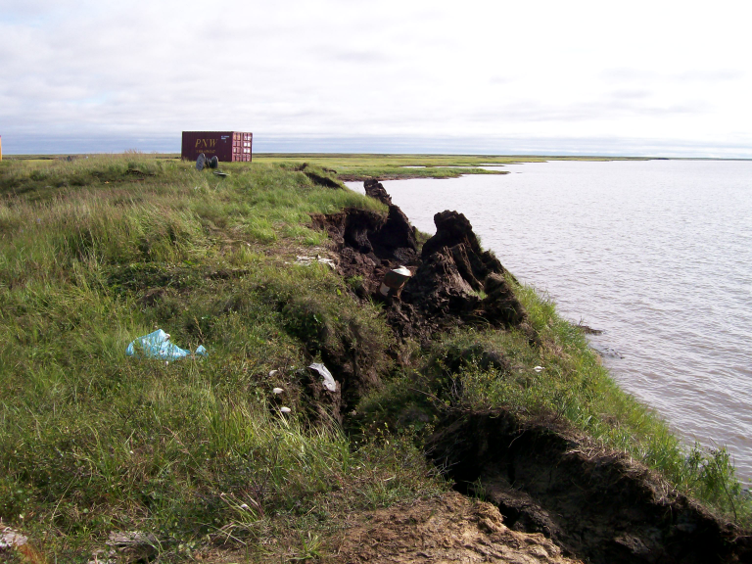
Notes:
11
The increased rates of shoreline sloughing of the Ninglick River has been attributed to thawing of the permafrost layer in the river bank and decreased extent and duration of sea ice in the Bering sea.

Slide 12
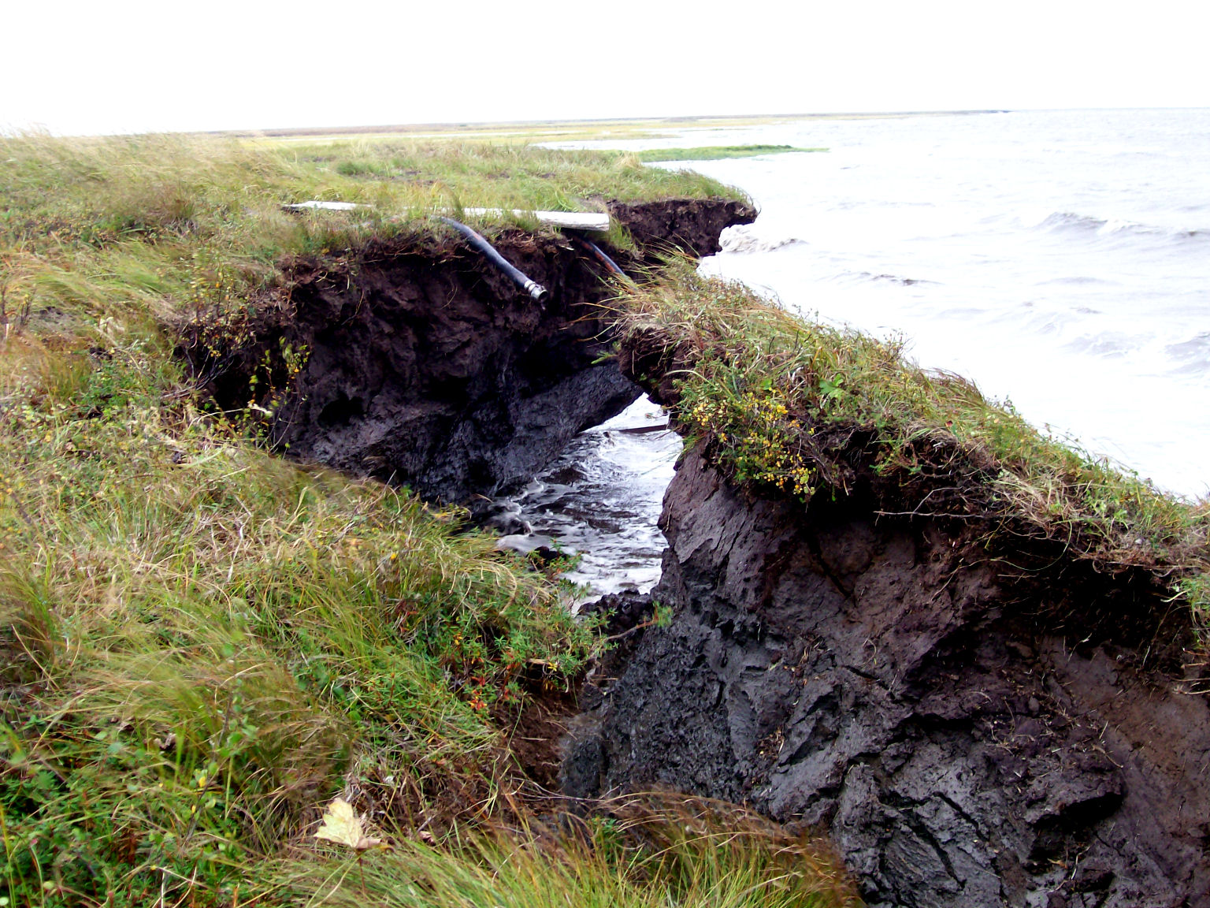
Notes:
12

Slide 13
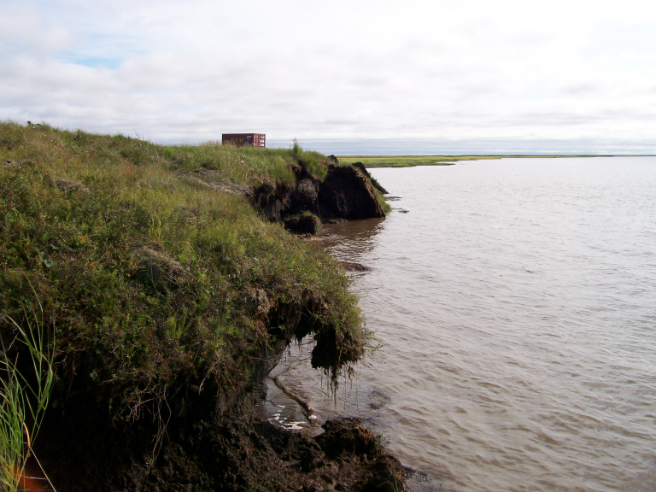
Notes:
13

Slide 14
“Not that long ago the water was far from our village and could not be easily seen from our homes. Today the weather is changing and is slowly taking away our village. Our boardwalks are warped, some of our buildings tilt, the land is sinking and falling away, and the water is close to our homes. The infrastructure that supports our village is compromised and affecting the health and well-being of our community members, especially our children.”
Newtok Traditional Council, Mertarvik Strategic Management Plan

Slide 15
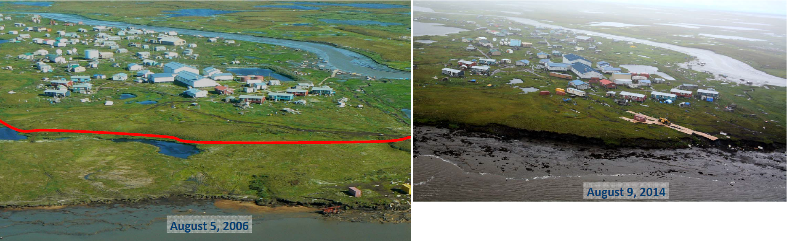
Newtok Shoreline Retreat, 2006 to 2014
“The Ninglick River is eroding toward Newtok at an average rate of 72 feet per year. The maximum yearly observed rate of erosion is 300 feet per year. At that rate, the Ninglick River would reach the community school by about 2017. The school is the largest and most important structure in the community. Its loss would severely impact the function and continued existence of the community.”
U.S. Army Corps of Engineers, Revised Environmental Assessment, Newtok Evacuation Center, Mertarvik, Nelson Island, Alaska

Slide 16
Flooding
Increased snowpack or rapid temperature increases can cause excessive glacial and snow melt at higher elevations, resulting in flooding
Lack of sea ice leaves coastal communities vulnerable to storm-surge resulting in flooding
Ice jams on rivers lead to flooding in riverine communities

Slide 17
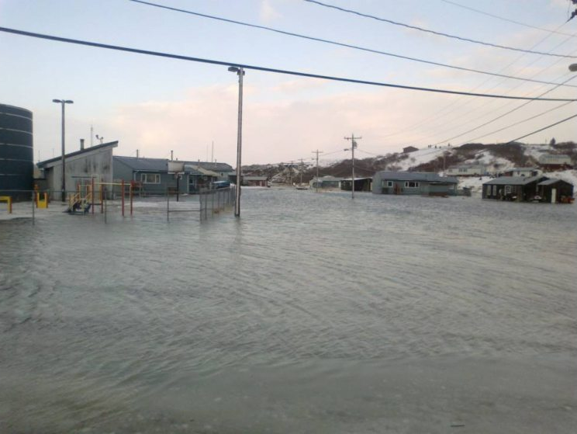
Golovin
Source: Anchorage Daily News

Slide 18
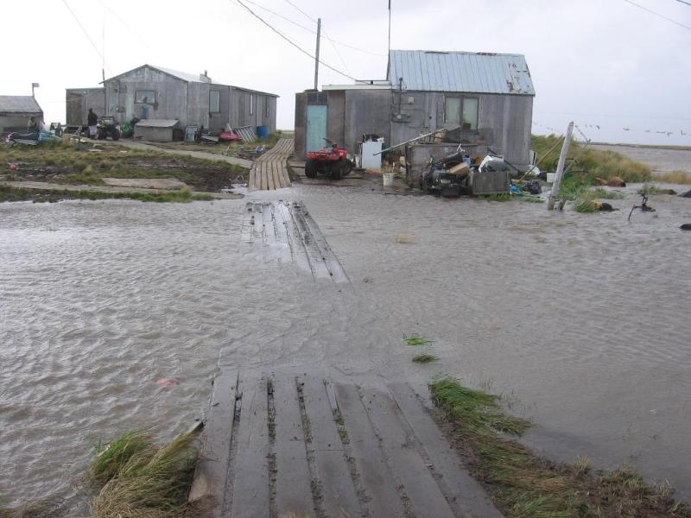
Newtok
Notes:
18
Severe flood events, such as the 20-year flood of 2005 and the lesser flood of 2006, permeate the village water supply, spread raw sewage through the community, displace residents from homes, destroy subsistence food storage, and shut down essential utilities. The U.S. Army Corps of Engineers predicts that the 50-year flood would flood almost the entire community. High ground is limited and high ground with shelter sufficient to house the community is non-existent.

Slide 19
Cumulative Impacts to Villages
Loss of land buffers due to erosion
Increased vulnerability to coastal storms due to loss of sea-ice; land to erosion
  Storm surge flooding
  Increased thawing of permafrost in river banks; coast leading to increased erosion;
Public health impacts from toxic/human waste in flood waters
Reduced food security – thawing of ice cellars, etc.

Slide 20
Impacts of Climate Change on Alaska
GAO Report 2003:
Flooding and erosion affect 184 of 213 (or about 86%) Alaska Native villages to some extent
Villages of Kivalina, Koyukuk, Newtok, and Shishmaref in imminent danger from flooding and erosion and planning to relocate.
GAO Report 2009:
31 villages imminently threatened by flooding and erosion.
At least 12 of 31 imminently threatened villages have decided to relocate—in part or entirely—or to explore relocation options.

Slide 21
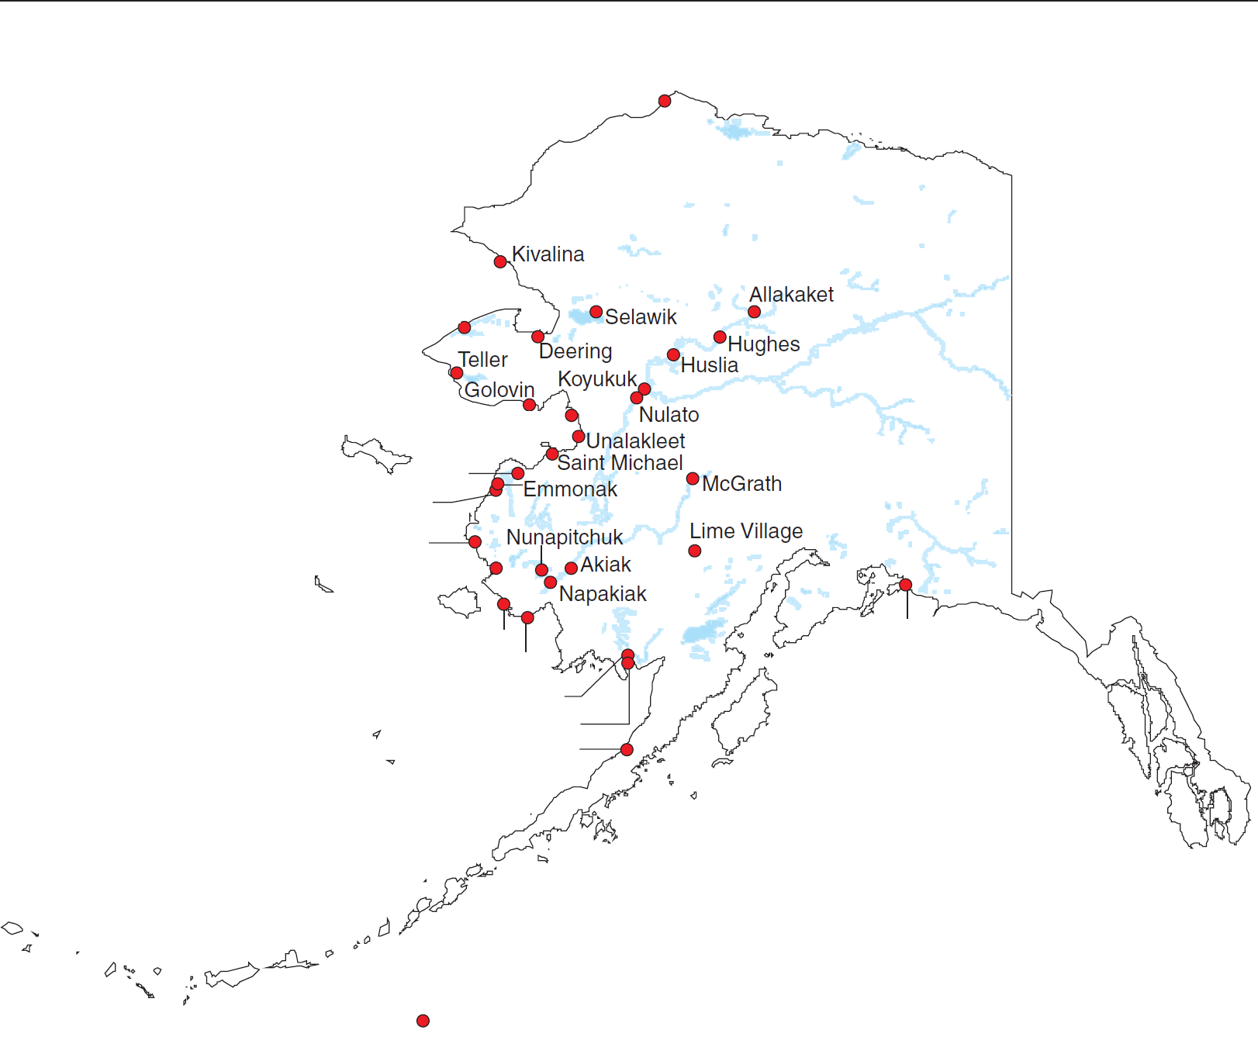
Impacts of Climate Change on Alaska
Barrow
Shishmaref
Shaktoolik
Kotlik
Alakanuk
Chevak
Newtok
Chefornak
Eyak
(Cordova)
Kwigillingok
Dillingham
Clarks Point
Port Heiden
31 imminently threatened villages
Sources: GAO (analysis); Pitney Bowes Business Insight (map)

Slide 22
Timeline of Events - Alaska
Dec. 2003 | GAO-04-142 Report on Alaska Native Villages, Erosion & Flooding
May 2006 | Newtok Planning Group organized
Nov. 29, 2006 | AO 231 establishes DCCED “to act as the state coordinating agency”
Jul. 10, 2006 | Legislature establishes AK Climate Impact Assessment Commission
Aug. 1, 2007 | First Alaska Climate Change Sub-Cabinet meeting held
Sep. 12-13, 2007 | Village of Kivalina self-evacuates during severe fall storm
Sep. 14, 2007 | Governor signs AO 238 for AK Climate Change Sub-Cabinet
Oct. 11, 2007 | Senate Coastal Erosion Field Hearing (Stevens and Landrieu)
Nov. 6, 2007 | Immediate Action Working Group established.
Nov. 19-20, 2007 | Sen. Stevens holds Roundtable on Coastal Erosion/Village Relocation. Alaska Climate Change Impact Mitigation Program proposed as one of State’s responses to issues
Jul. 1, 2008 | Alaska Climate Change Impact Mitigation Program funded
2008 - 2009 | Development of Alaska Climate Change Strategy – Adaptation, Mitigation, Immediate Action, and Research Need Reports
Jun. 2009 | GAO-09-551 Report on Relocation of Alaska Native Villages
Jan. 11, 2010 | Mertarvik Strategic Management Plan funded
May 9, 2012 | Alaska Community Coastal Protection Project funded

Slide 23
Alaska Climate Change Impact Mitigation Program
Established to provide funding and technical assistance to communities imminently threatened by climate-related natural hazards.
Intended to assist impacted communities develop planned approach to shoreline protection, building relocation and/or eventual relocation of the village.
Also intended to address Alaska Congressional Delegation’s request that State of Alaska participate with federal government in addressing climate-change impacts on Alaska’s communities.

Slide 24
Implemented through technical assistance and two funding sources
Hazard Impact Assessments:
Identify and document climate change-related hazards
Analyze hazard trends and future impacts to community
Recommend solutions to mitigate impacts of local natural hazards, taking into account financial considerations
Community Adaptation Planning Grants:
Based on recommendations of Hazard Impact Assessment
Brings community to next stage in addressing hazards

Slide 25
Hazard Impact Assessments
Identify and document climate change-related hazards
Analyze hazard trends and future impacts to community
Recommend solutions to mitigate impacts of local natural hazards, taking into account financial considerations

Slide 26
Community Decision-Making Process: Phase 1

Slide 27
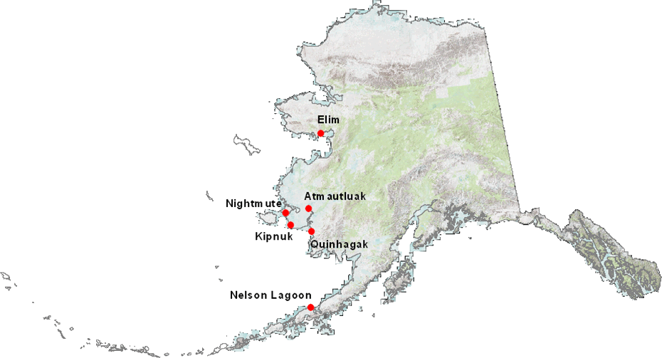
Communities receiving
Hazard Impact Assessment Grants

Slide 28
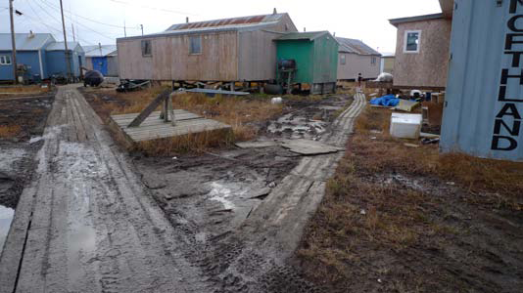
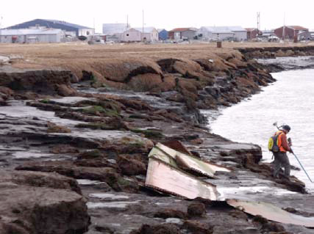
Kipnuk
Erosion of Kiguklik River, mostly during fall storms
Seasonal flooding and storm surges causing over-topping of sewage lagoon, dispersal of fuel
Thawing permafrost causing subsidence - loss of foundation support, threatening structures
Photo: Golder & Associates
Photo: Golder & Associates

Slide 29
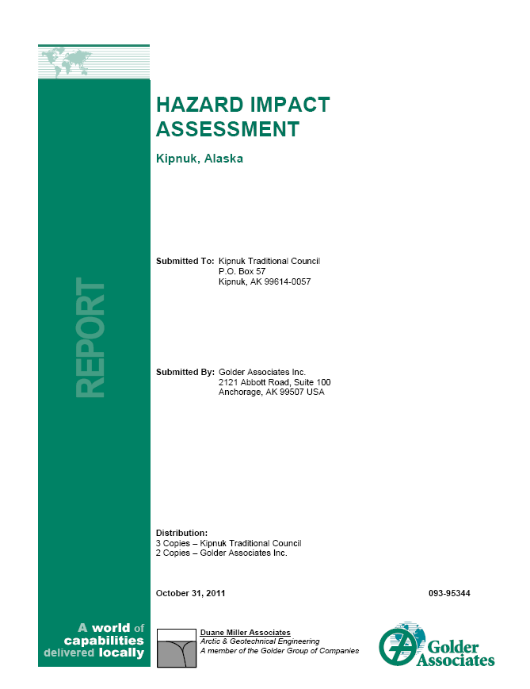
Kipnuk Hazard Impact Assessment
Recommendations will provide basis for Community Planning Grant
Shoreline protection to reduce rate of riverbank erosion, such as sheet piles, rip-rap, seawall, and river course modification
Elevate structures above flood levels. Use of appropriate foundations such as pile or triodetic foundations to address permafrost degradation
Adopt building code setting minimum floor height for new structures
Install flood warning system including monitoring component to collect data for forecasting severity of storm surges
Construct levee system to protect village from flooding
Insulated pads to elevate the relative ground surface

Slide 30
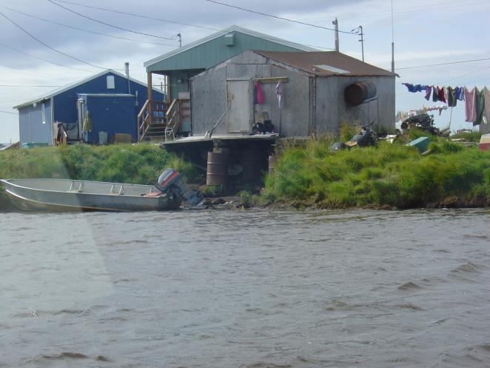
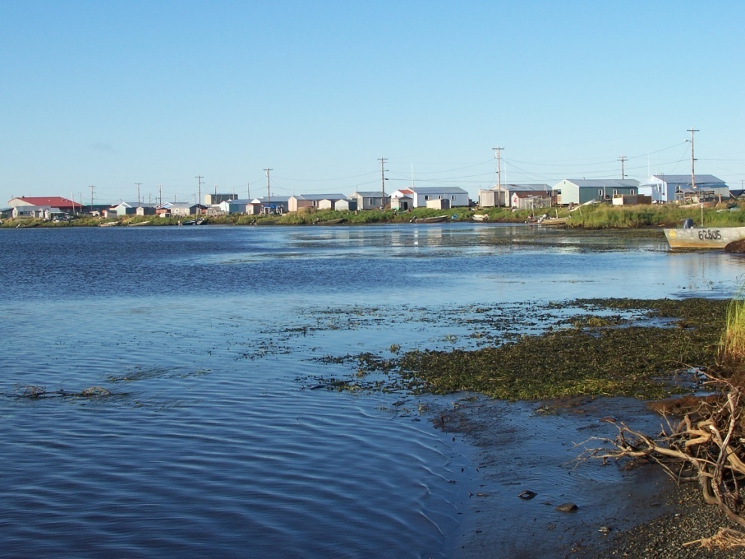
Atmautluak
Erosion caused by thawing permafrost and ice jams
Flooding caused by ice jamming of local river
Thawing permafrost impacting village roads, utility infrastructure (telephone, electrical and fuel lines)
Photo: WH Pacific
Photo: WH Pacific

Slide 31
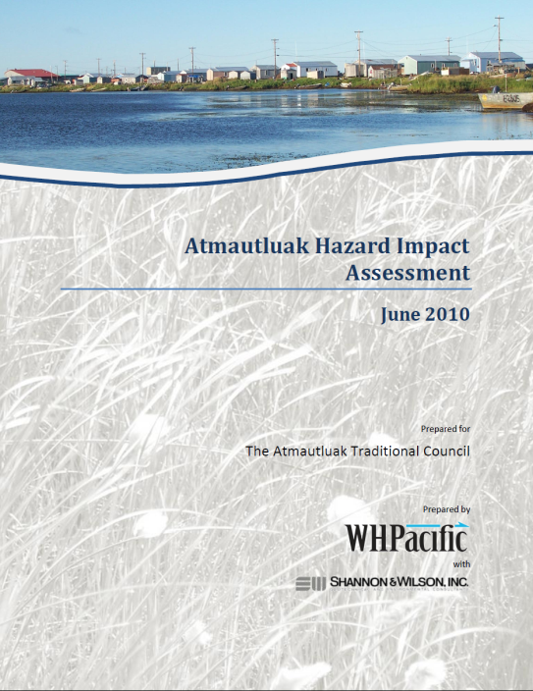
Atmautluak Hazard Impact Assessment
Recommendations will provide basis for Community Planning Grant
Conduct hydrological study to quantify recurrence intervals of floods and to evaluate alternatives to reduce bank erosion
Require that future projects install thermistors to document changes in the active layer
Monitor erosion through bank migration study (aerial photographs and physical measurements)
Raise fuel lines off ground to reduce susceptibility to subsidence and subsequent corrosion
Prepare community land use plan to identify preferred locations for new housing or other community facilities or infrastructure
Prepare community surface drainage plan to drain surface water into nearby lakes and rivers
Move or replace structures in danger from riverine erosion

Slide 32
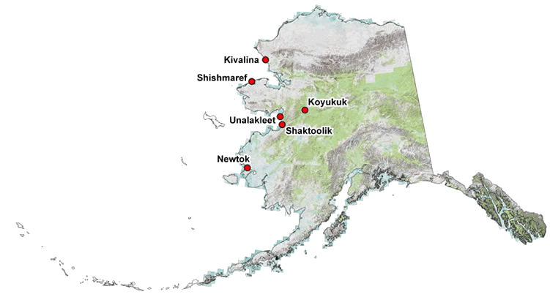
Communities receiving
Adaptation Planning Grants

Slide 33
Community Decision-Making Process: Phase 2

Slide 34
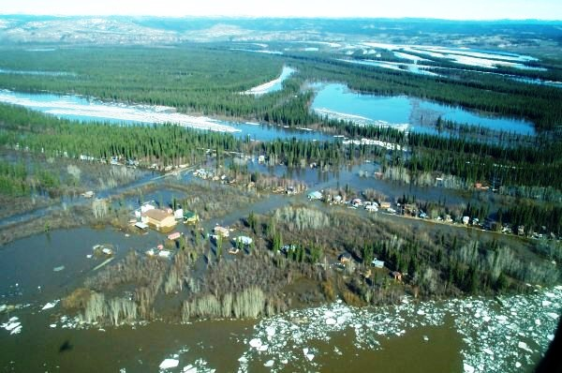
Koyukuk
Entire village is built within floodplain of Koyukuk River
Threatened seasonally by wildfire, ice dams, and flooding/erosion resulting from ice dams
Community eventually plans to move to higher ground at nearby Koyukuk Mountain

Slide 35
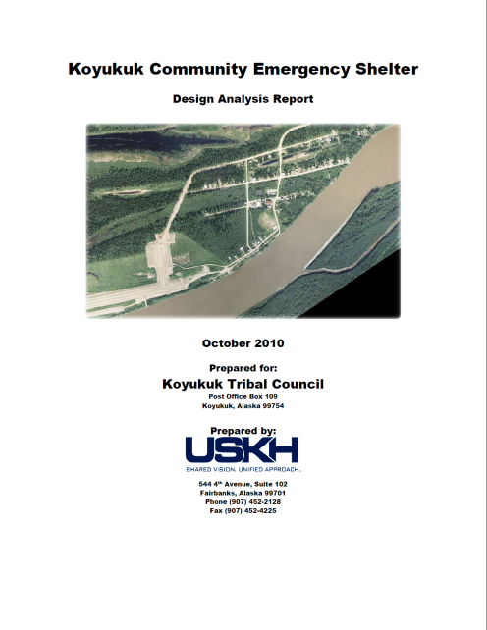
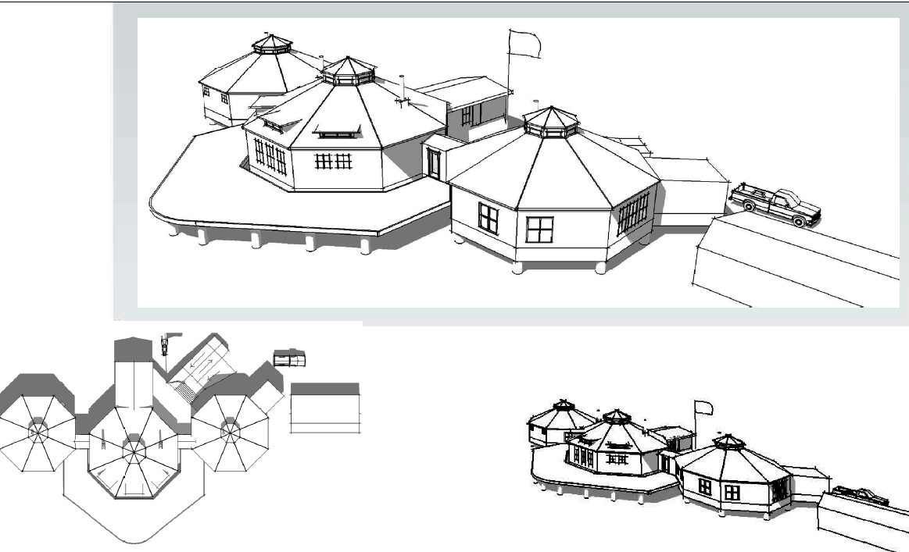
Koyukuk Community Emergency Shelter
Proposed to provide shelter for community during flood events
Will serve as command post and “safe house” accessible to community
Facilitates evacuations, provides temporary housing, and enables return of residents to their homes in safe manner

Slide 36
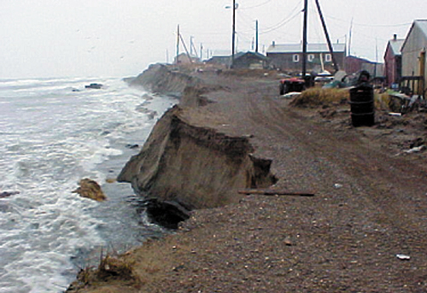
Shishmaref
Seawall has been built to protect community as a temporary measure
Community looking at relocation as long-term solution
Photo: Shishmaref Relocation Coalition

Slide 37
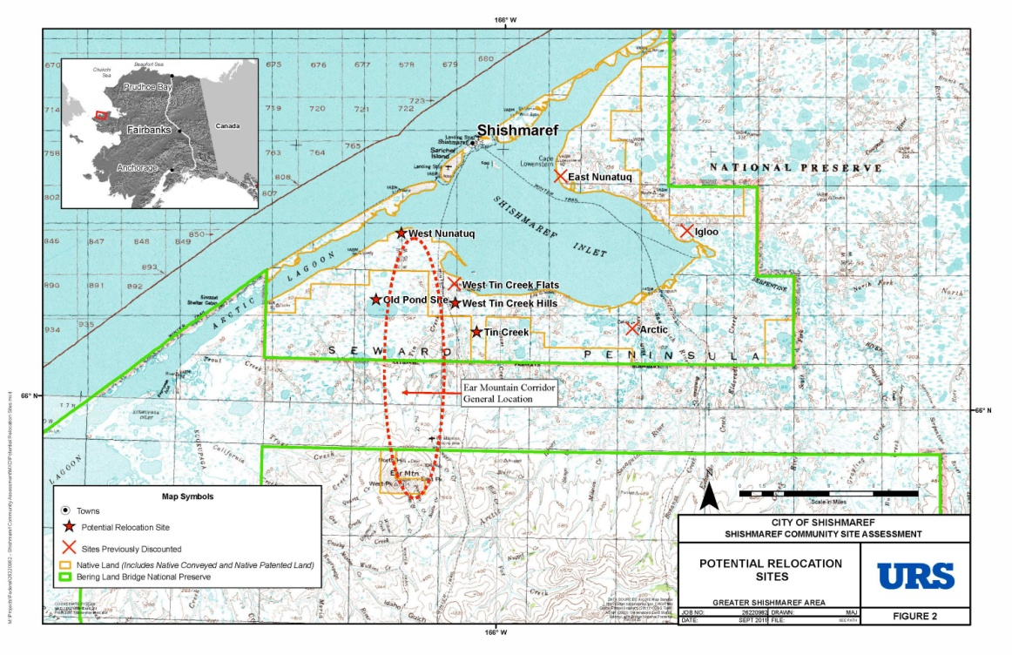
Shishmaref Community Relocation Site Selection Feasibility Study
Community has hired consulting firm (URS Corporation) to:
  work with community to organize and review prior relocation studies
  reconfirm community values and technical considerations for site selection criteria
  evaluate remaining candidate sites and need for any new sites
  identify at least one relocation site with broad community support and reasonable constructability
  identify initial next steps for pioneer development.

Slide 38
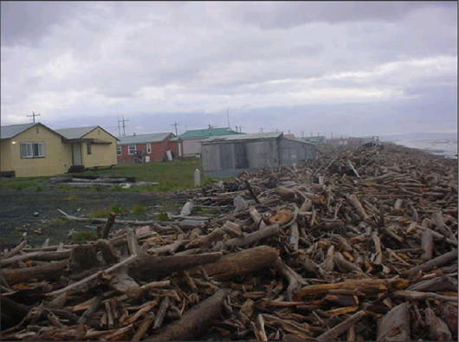
Shaktoolik
Berm between village and the beach is composed largely of naturally deposited driftwood logs
Village becomes an island during storm surges, and then it is additionally threatened by ocean waves throwing these logs into town
Photo: Steve Ivanoff

Slide 39
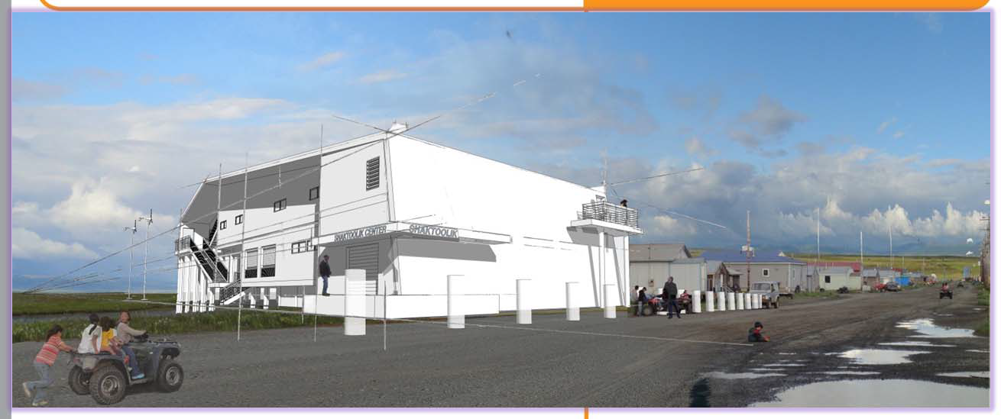
Shaktoolik Evacuation Shelter Design Analysis Report
Shaktoolik hired a contractor to develop a concept-level design for an elevated structure which will provide shelter for the community during emergencies, principally during storm surges, but also in other extreme weather events and serve other non‐emergency functions.

Slide 40
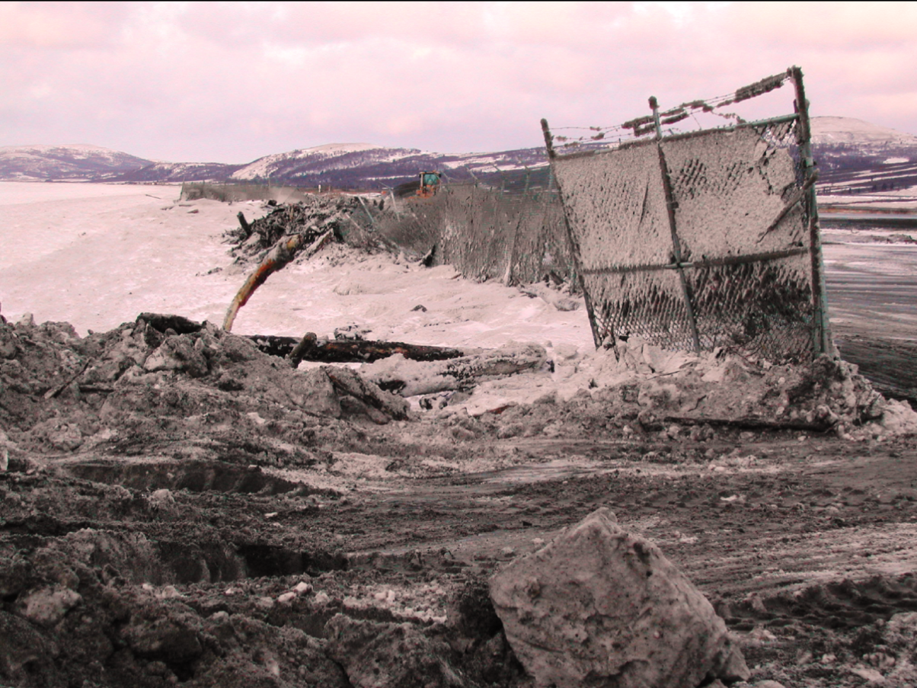
Unalakleet
Community has developable land nearby and can resolve issues by moving infrastructure/facilities away from source of impact
Photo: Steve Ivanoff

Slide 41
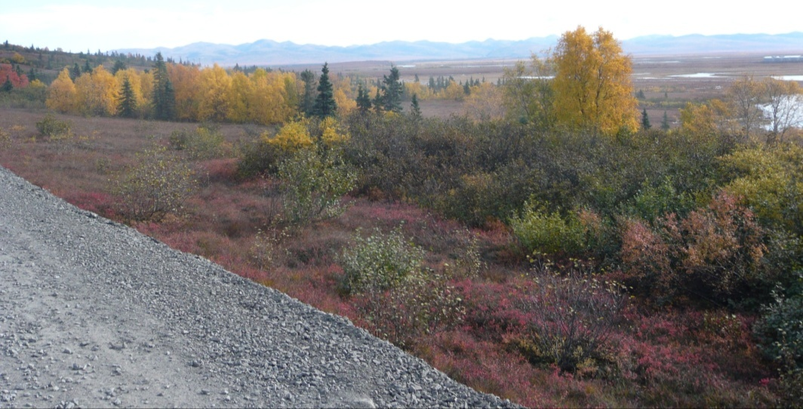
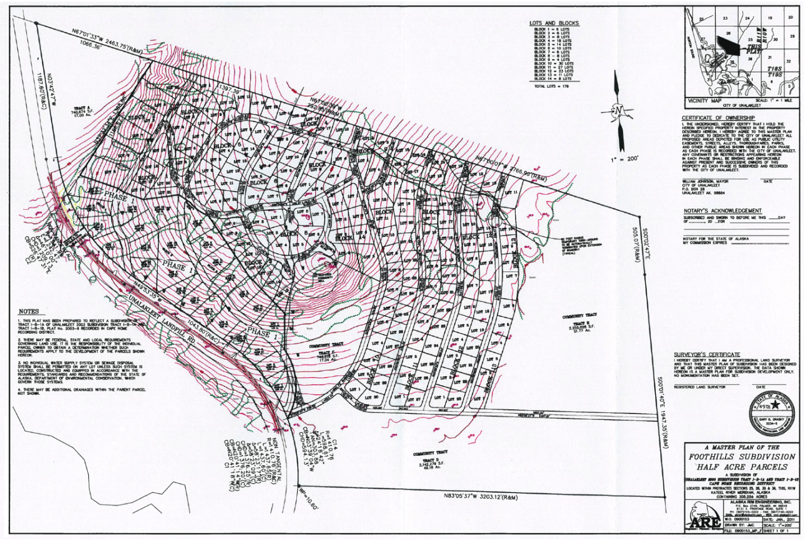
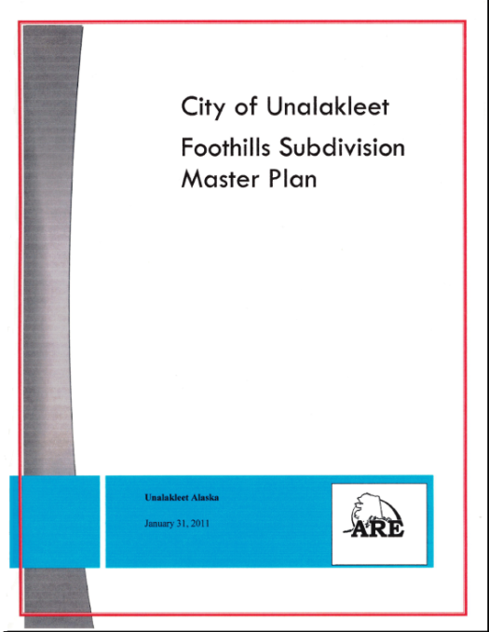
Foothills Master Plan and Subdivision Design Project
Directs new development to higher ground, away from impacts of erosion, flooding, and storm surge.
Photo: Sally Russell Cox

Slide 42
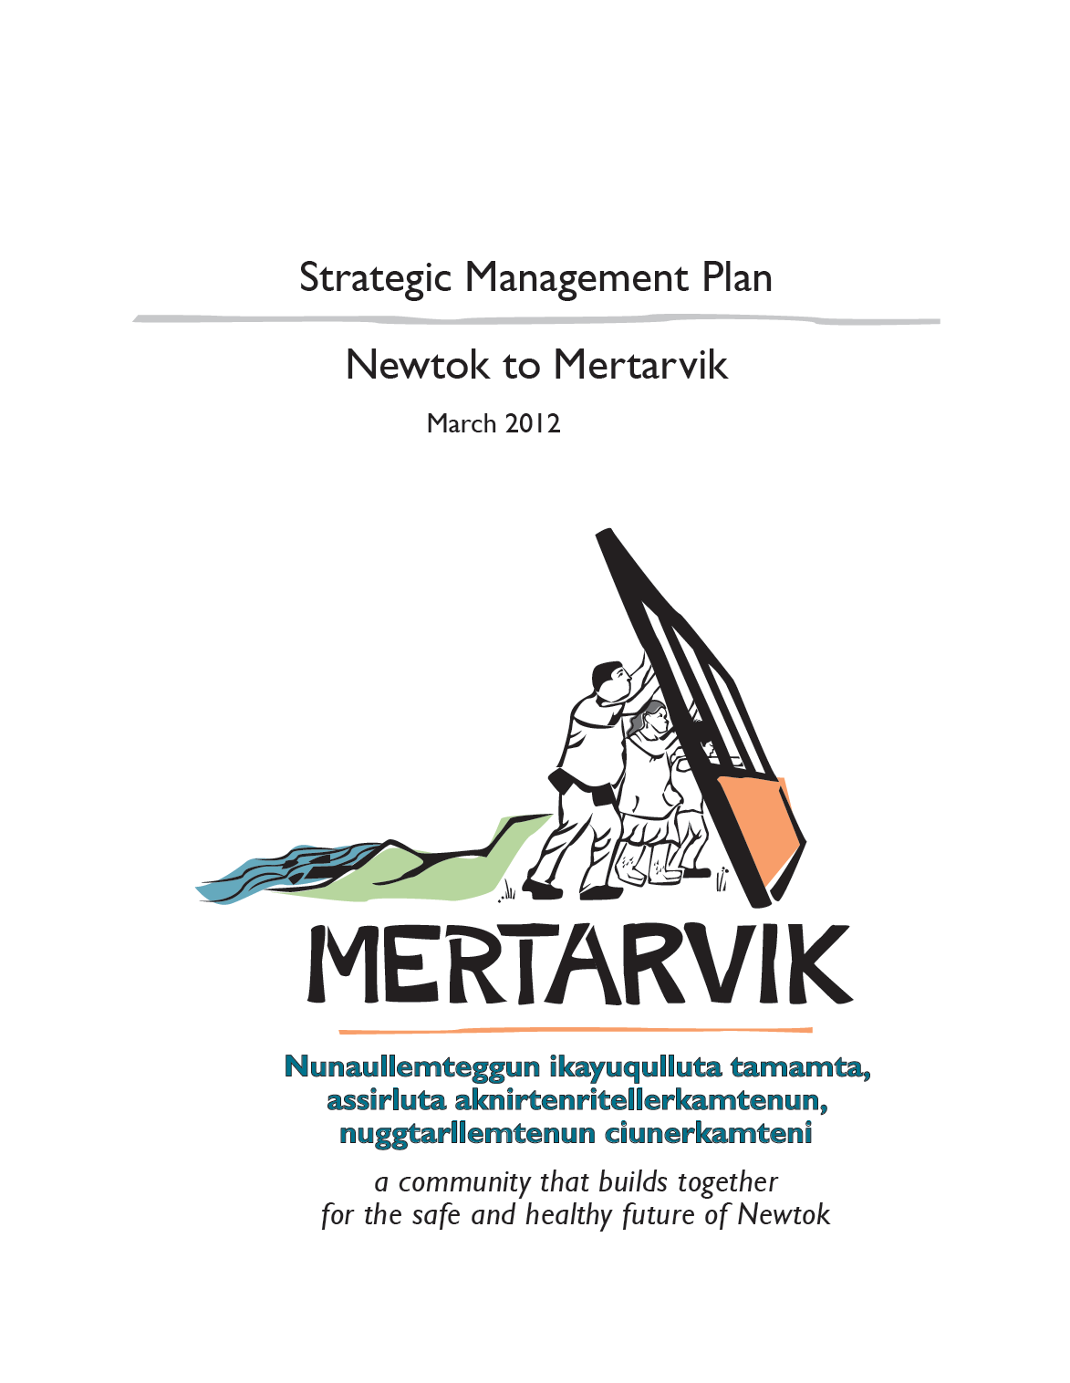
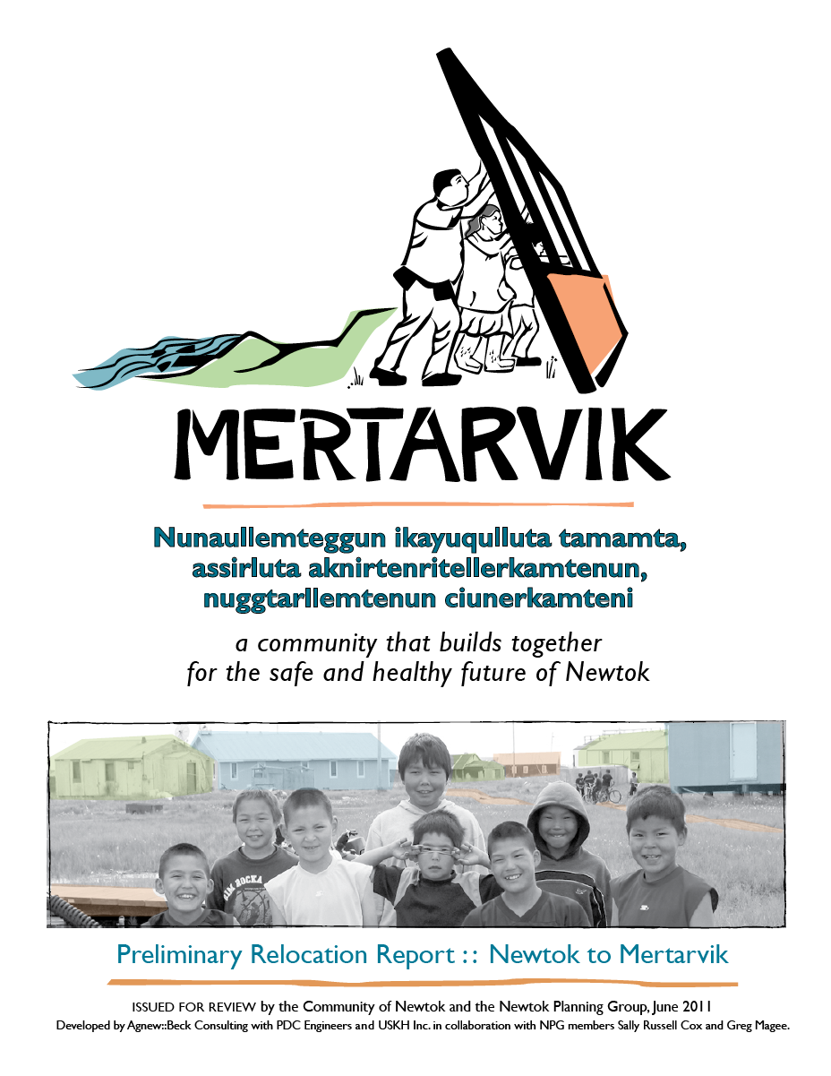
Mertarvik Strategic Management Plan
Sets a common vision for relocating the village of Newtok to relocation site on Nelson Island.
Notes:
DCRA acquired funding through the federal Coastal Impact Assistance Program for a Strategic Management Plan for the Newtok relocation, and in 2011, the Newtok Planning Group began working with a contractor to develop the Strategic Management Plan.

Slide 43
Develops a Collective Vision: focuses the resources of the community and supporting partnerships behind a common vision and common set of priorities.
Establishes a Framework for Other Plans: serves as an “umbrella document” for relocation activities. All other plans, policies and strategies will support the strategic management plan and take direction from it.
Communicates the Relocation Strategy: establishes and communicates the “blueprint” for relocation in a positive and practical way to everyone in the community, government agencies, and other organizations.
Facilitates Effective Partnerships: strengths existing and builds new partnerships with different levels of government, as well as other partners and funders. These partnerships are essential to achieving the strategic actions of the plan.

Slide 44
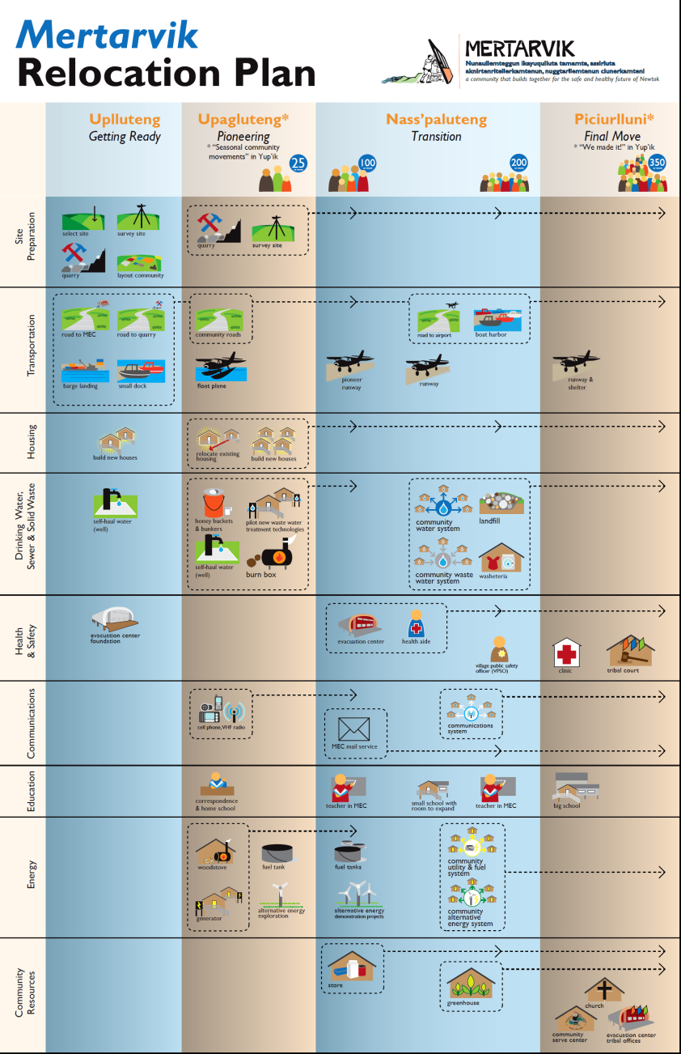
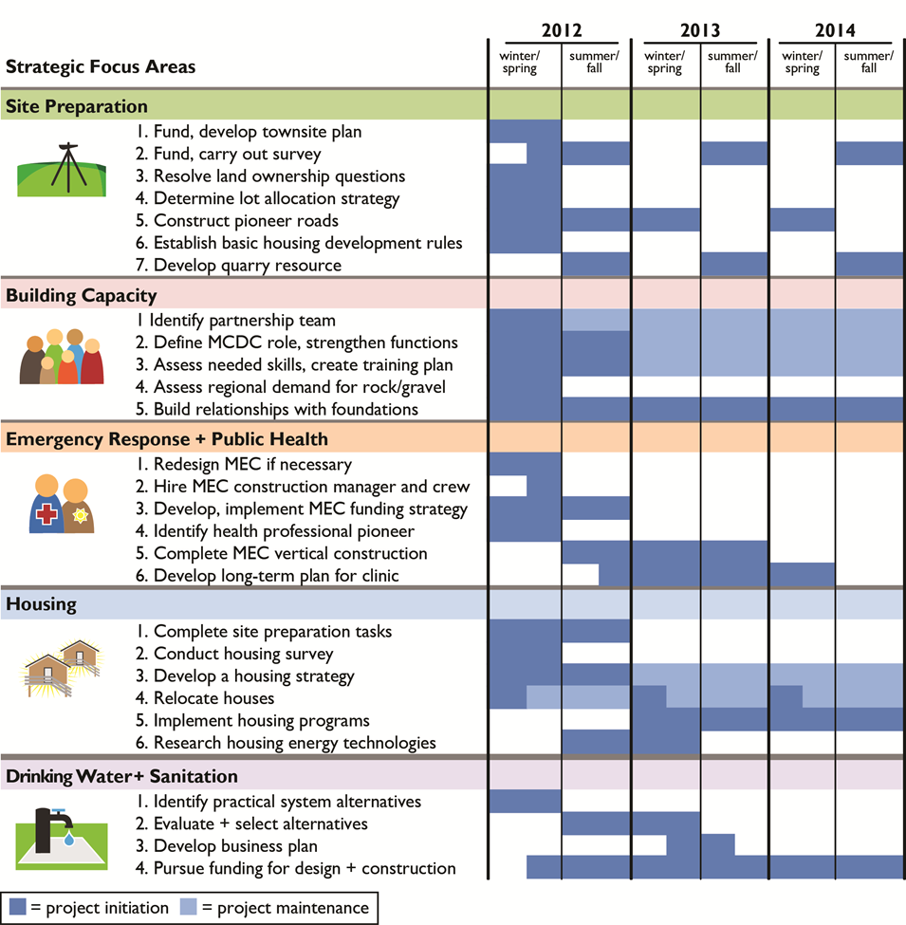
Notes:
DCRA acquired funding through the federal Coastal Impact Assistance Program for a Strategic Management Plan for the Newtok relocation, and in 2011, the Newtok Planning Group began working with a contractor to develop the Strategic Management Plan.

Slide 45
Community Decision-Making Process: Phase 3

Slide 46
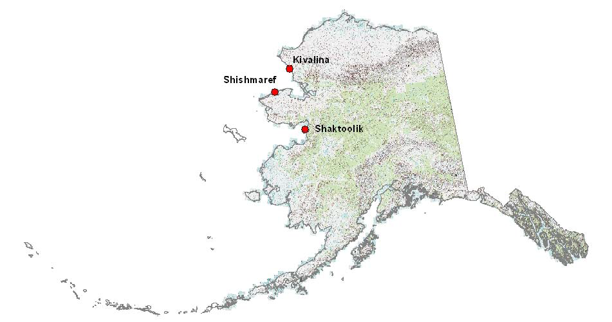
Alaska Community
Coastal Protection Project

Slide 47
Objective
To increase community sustainability and resilience to the impacts of natural hazards.

Slide 48
Essential Components
Strong community leadership
Agency support and collaboration
Careful, effective planning

Slide 49
Strong Community Leadership
Community grant for full-time Community Coordinator to:
  Represent community at interagency working group meetings
  Work with project staff, inter-agency group, and planning contractor on resiliency plan
  Advocate for funding to carry out resiliency plan
DCRA provides training, technical assistance and other support to Community Coordinator

Slide 50
Agency Support and Collaboration
Organization of interagency working group (state/federal agencies and regional organizations):
To coordinate resources and technical assistance to help community implement resiliency plan.

Slide 51
Careful, Effective Planning
Comprehensive Strategic Management Plan:
Contractor hired to work with community and inter-agency working group to develop strategic management plan -- “blueprint” for how the community and agencies will proceed over the next 10 – 20 years to accomplish the community’s recommended actions.
Plan is community-driven, with technical support provided by agencies:
  Sequencing of activities and projects to implement plan
  Potential funding sources; identification of critical funding cycles and opportunities
  Identification of potential resource-leveraging opportunities among agencies
  Identification of construction windows

Slide 52
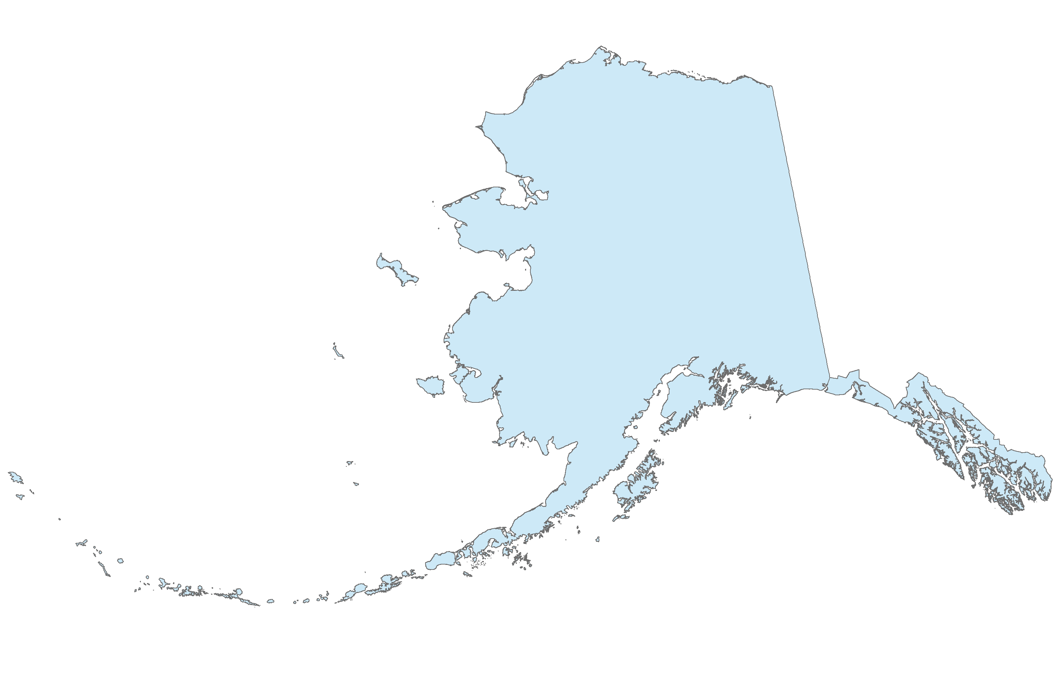
Most Imminently Threatened Communities
Kivalina
Shishmaref
Shaktoolik
Newtok

Slide 53
Hazard Impact Assessments Completed
Ready to Begin Adaptation Planning Process
Elim
Nightmute
Atmautluak
Kipnuk
Quinhagak
Nelson Lagoon

Slide 54
Communities Requiring DCRA Assistance
Barrow
Deering
Selawik
Allakaket
Hughes
Teller
Koyukuk
Huslia
Nulato
Golovin
Saint Michael
Kotlik
McGrath
Alakanuk
Emmonak
Chevak
Nunapitchuk
Akiak
Lime Village
Eyak
Napakiak
Chefornak
Dillingham
Kwigillingok
Clark’s Point
Port Heiden

Slide 55
Sally Russell Cox
State of Alaska
Department of Commerce, Community, and Economic Development
Division of Community and Regional Affairs
Email: sally.cox@alaska.gov
Phone: 907.269.4588
Web: http://commerce.state.ak.us/dnn/dcra/PlanningLandManagement/ACCIMP.aspx
http://commerce.state.ak.us/dnn/dcra/PlanningLandManagement/AlaskaCommunityCoastalProtectionProject.aspx
http://commerce.state.ak.us/dnn/dcra/PlanningLandManagement/NewtokPlanningGroup/MertarvikStrategicManagementPlan.aspx

