Slide 1
Strengthening Local Resilience through Community-Based Adaptation Efforts
Sally Russell Cox, Alaska Division of Community and Regional Affairs  Rights, Resilience and Community-based Adaptation workshop September 20, 2016

Slide 2
“Not that long ago the water was far from our village and could not be easily seen from our homes. Today the weather is changing and is slowly taking away our village. Our boardwalks are warped, some of our buildings tilt, the land is sinking and falling away, and the water is close to our homes. The infrastructure that supports our village is compromised and affecting the health and well-being of our community members, especially our children.”
Newtok Resident, from Mertarvik Strategic Management Plan

Slide 3
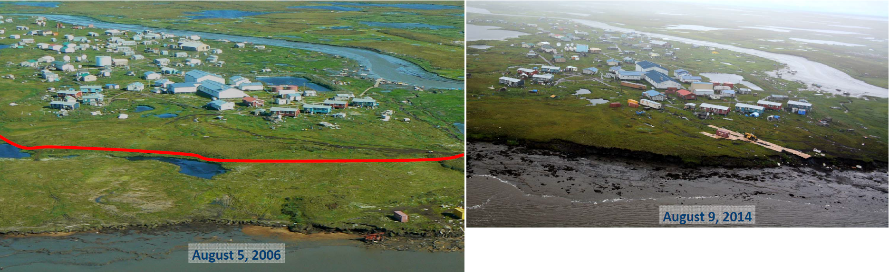
Newtok Shoreline Retreat, 2006 to 2014
“The Ninglick River is eroding toward Newtok at an average rate of 72 feet per year. The maximum yearly observed rate of erosion is 300 feet per year. At that rate, the Ninglick River would reach the community school by about 2017. The school is the largest and most important structure in the community. Its loss would severely impact the function and continued existence of the community.”
U.S. Army Corps of Engineers, Revised Environmental Assessment, Newtok Evacuation Center, Mertarvik, Nelson Island, Alaska

Slide 4
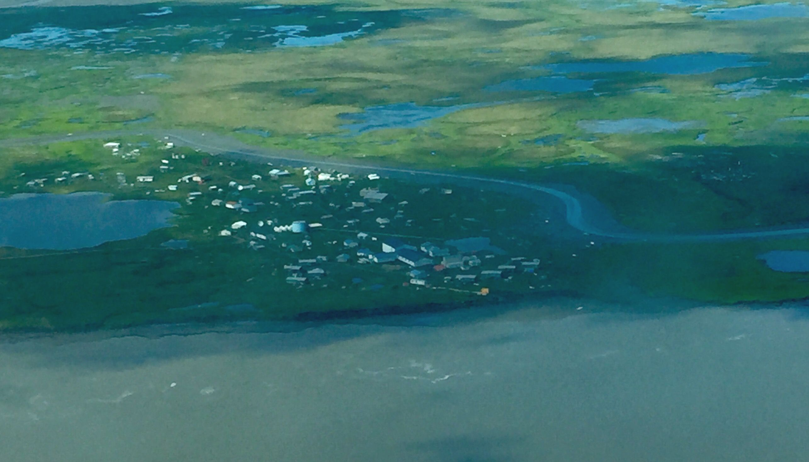
Newtok Shoreline, July 16, 2016

Slide 5
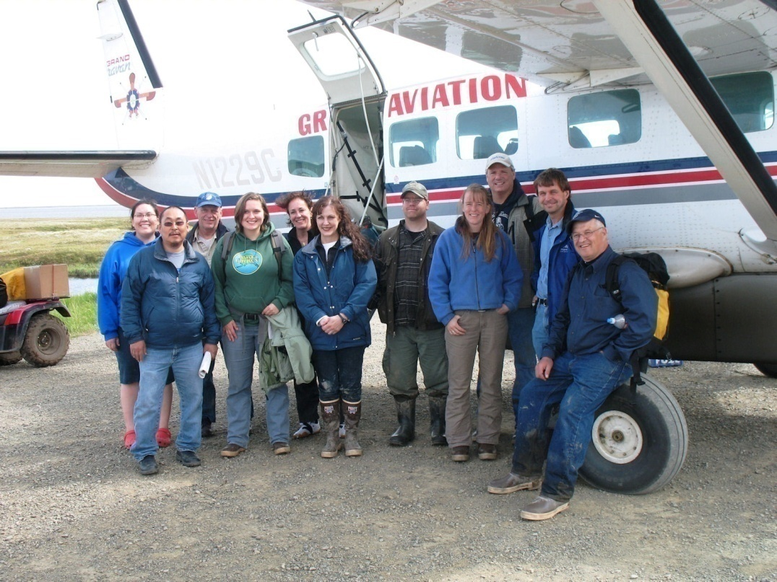
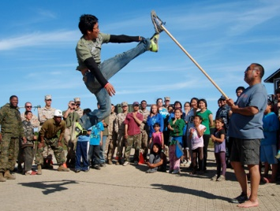
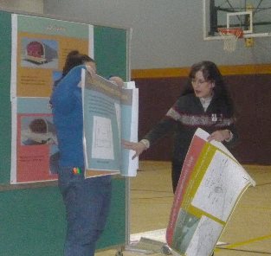
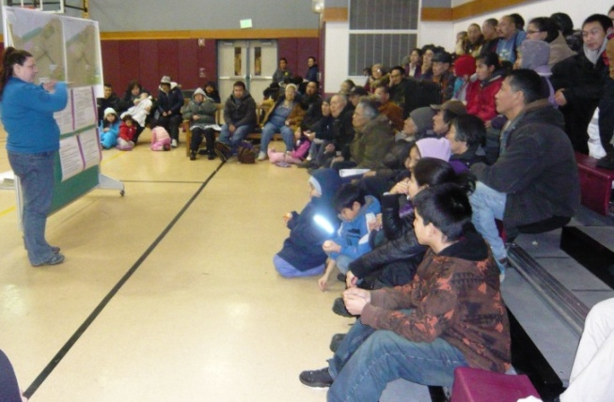
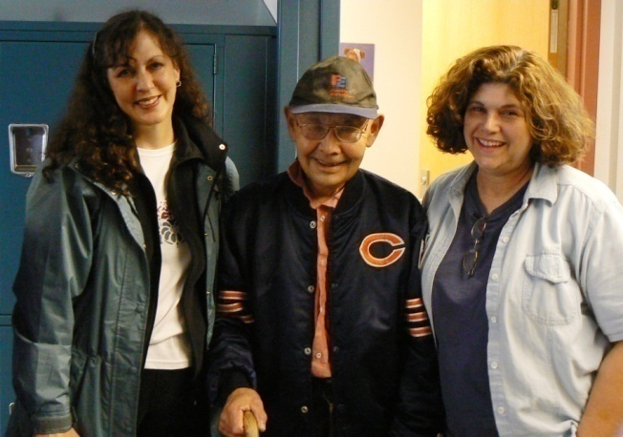
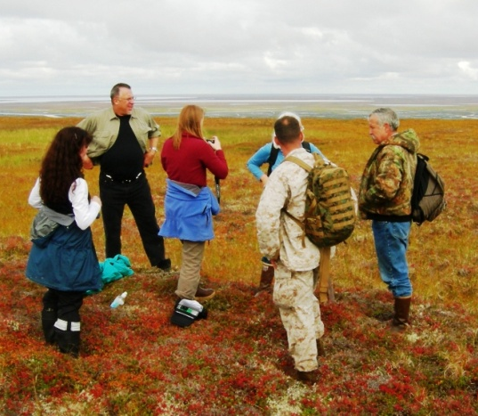
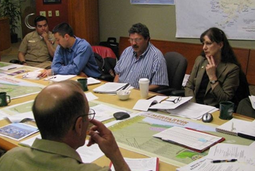
Newtok Planning Group
Notes:
In 2006, the village of Newtok requested assistance from the Division of Community and Regional Affairs. The Newtok Planning Group was formed shortly thereafter.

Slide 6
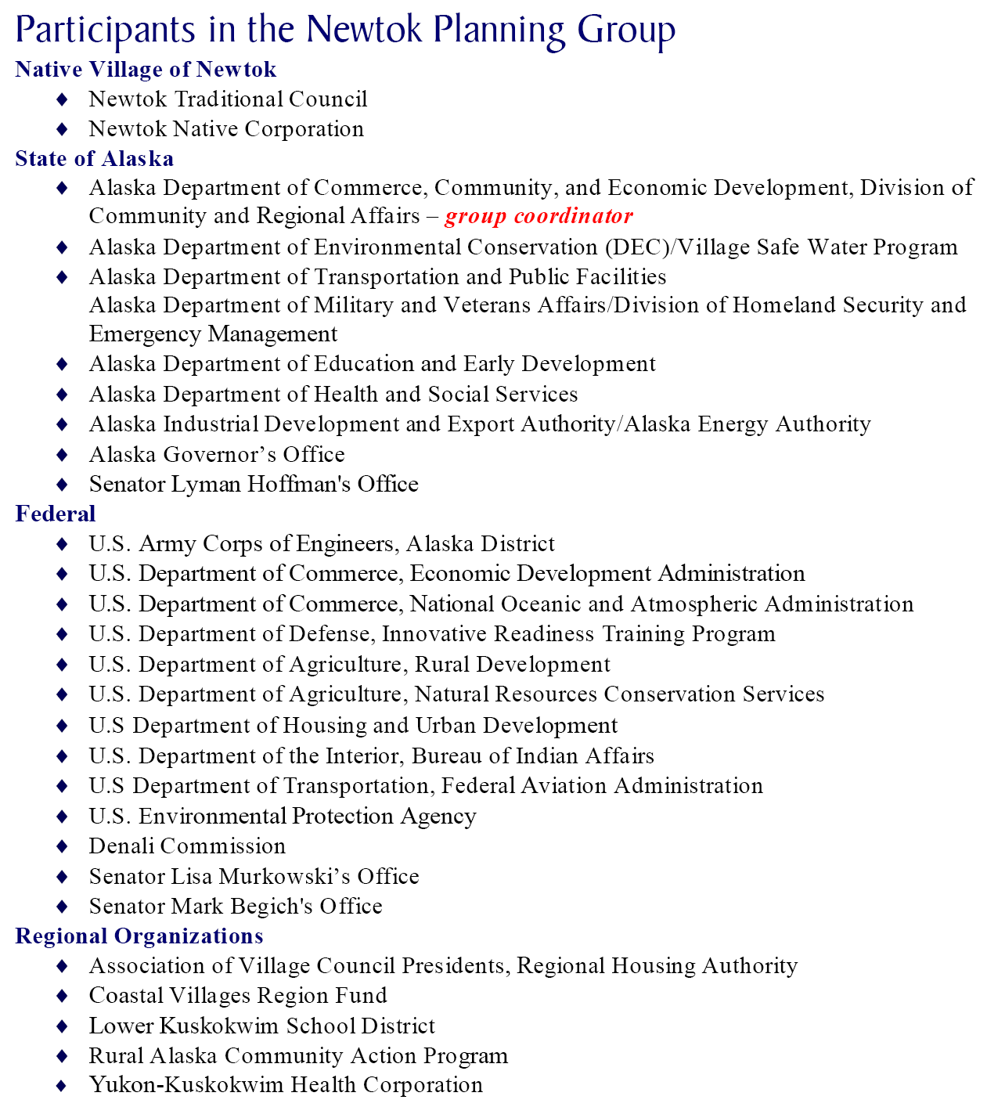

Participants in Newtok Planning Group
Native Village of Newtok
Newtok Village Council
Newtok Native Corporation
State of Alaska
Alaska Department of Commerce, Community, and Economic Development– group coordinator
Alaska Department of Environmental Conservation (DEC)/Village Safe Water Program
Alaska Department of Transportation and Public Facilities
Alaska Department of Military and Veterans Affairs/Division of Homeland Security and Emergency Management
Alaska Department of Education and Early Development
Alaska Department of Health and Social Services
Alaska Industrial Development and Export Authority/Alaska Energy Authority
Alaska Governor’s Office
Alaska Legislative Representatives
Federal
U.S. Army Corps of Engineers, Alaska District
U.S. Department of Commerce, Economic Development Administration
U.S. Dept. of Commerce, National Oceanic and Atmospheric Administration
U.S. Dept. of Defense, Innovative Readiness Training Program
U.S. Dept. of Agriculture, Rural Development
U.S. Dep. of Agriculture, Natural Resources Conservation Services
U.S Department of Housing and Urban Development
U.S. Department of the Interior, Bureau of Indian Affairs
U.S Department of Transportation, Federal Aviation Administration
U.S. Environmental Protection Agency
Denali Commission
Alaska Congressional Delegation Representatives
Regional Organizations
Association of Village Council Presidents, Regional Housing Authority
Alaska Native Tribal Health Consortium
Coastal Villages Region Fund
Lower Kuskokwim School District
Rural Alaska Community Action Program
Yukon-Kuskokwim Health Corporation
Notes:
6
This group of representatives from State, federal and regional organizations began to meet with the goal of coordinating resources and assistance to help the Village of Newtok in its relocation efforts.
Today the Newtok Planning Group has representatives from the community; state and federal, and regional organizations.

Slide 7
Partnering with the Village of Newtok
since 2006
Community-driven
Voluntary
Regular meetings and agency project updates provide for enhanced communication among community and agencies
Collaboration has resulted in cost-savings and leveraging of resources
Better coordination of work
Reduced conflicts in project timelines and construction windows
Notes:
The Newtok Planning Group has met regularly since its inception, working across agencies to secure funding and establish a framework and strategy for moving the relocation process forward. Funding has been obtained for the development of several groundwork-laying infrastructure projects at Mertarvik. The strategy has been to fund and build pioneer infrastructure to jump-start the relocation process and trigger additional investments.

Slide 8
Relocation Activities at Mertarvik,
2006 - 2016

Slide 9
Alaska Climate Change Impact Mitigation Program
Established to provide funding and technical assistance to communities imminently threatened by climate-related natural hazards.
Intended to assist impacted communities develop planned approach to shoreline protection, building relocation and/or eventual relocation of the village.
Also intended to address Alaska Congressional Delegation’s request that State of Alaska participate with federal government in addressing climate-change impacts on Alaska’s communities.

Slide 10
Hazard Impact Assessments
Identify and document climate change-related hazards
Analyze hazard trends and future impacts to community
Recommend solutions to mitigate impacts of local natural hazards, taking into account financial considerations

Slide 11
Community Decision-Making Process: Phase 1

Slide 12
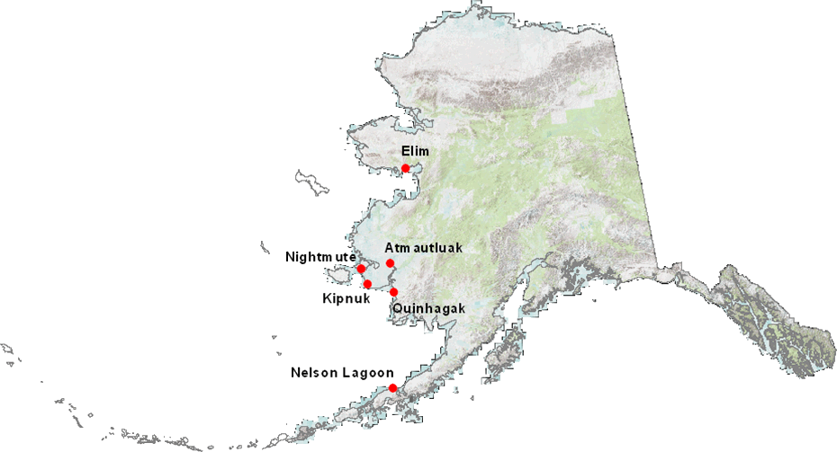
Communities receiving
Hazard Impact Assessment Grants

Slide 13
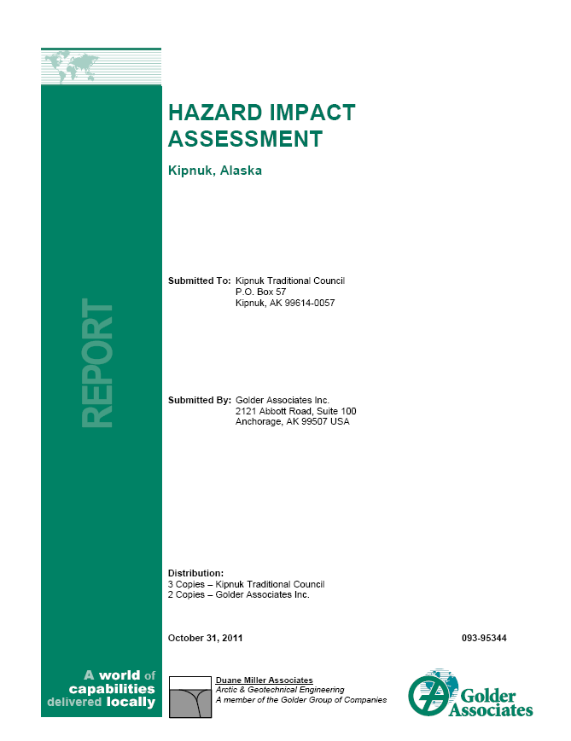
Kipnuk Hazard Impact Assessment
Recommendations will provide basis for Community Planning Grant
Shoreline protection to reduce rate of riverbank erosion, such as sheet piles, rip-rap, seawall, and river course modification
Elevate structures above flood levels. Use of appropriate foundations such as pile or triodetic foundations to address permafrost degradation
Adopt building code setting minimum floor height for new structures
Install flood warning system including monitoring component to collect data for forecasting severity of storm surges
Construct levee system to protect village from flooding
Insulated pads to elevate the relative ground surface

Slide 14
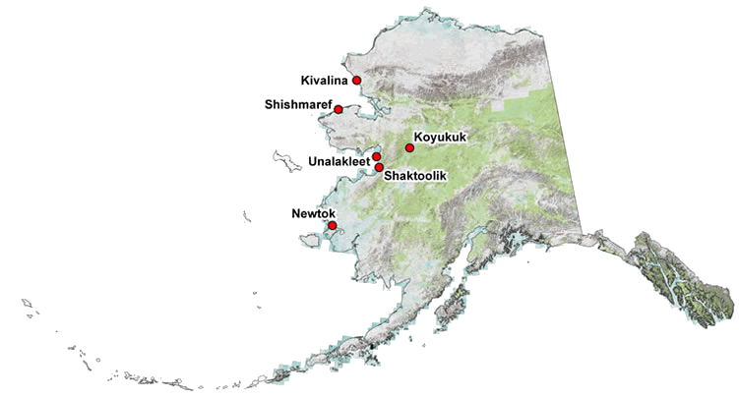
Communities receiving
Adaptation Planning Grants

Slide 15
Community Decision-Making Process: Phase 2

Slide 16
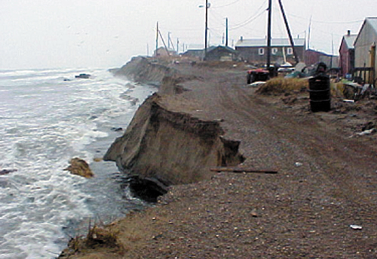
Shishmaref
Seawall has been built to protect community as a temporary measure
Community looking at relocation as long-term solution
Photo: Shishmaref Relocation Coalition

Slide 17
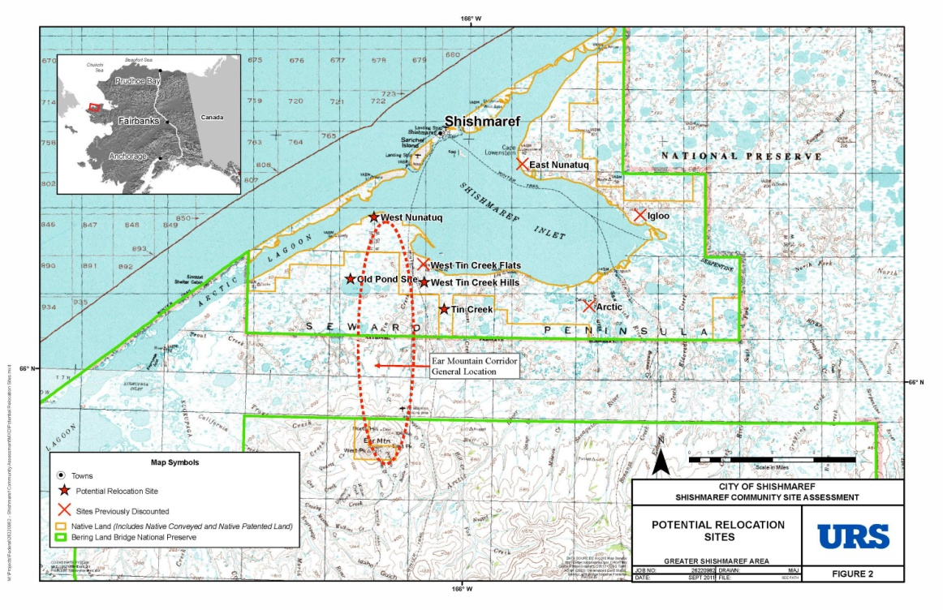
Shishmaref Community Relocation Site Selection Feasibility Study
Community hired consulting firm (URS Corporation) to:
  work with community to organize and review prior relocation studies
  reconfirm community values and technical considerations for site selection criteria
  evaluate remaining candidate sites and need for any new sites
  identify at least one relocation site with broad community support and reasonable constructability
  identify initial next steps for pioneer development.

Slide 18
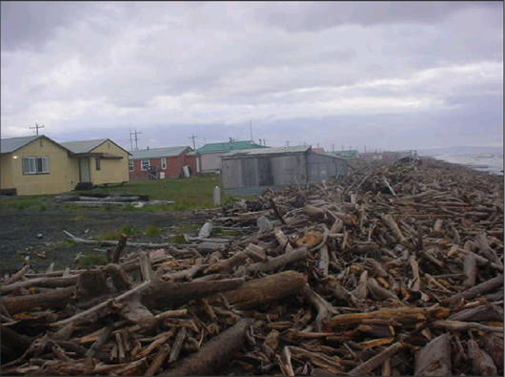
Shaktoolik
Berm between village and the beach is composed largely of naturally deposited driftwood logs
Village becomes an island during storm surges, and then it is additionally threatened by ocean waves throwing these logs into town
Photo: Steve Ivanoff

Slide 19
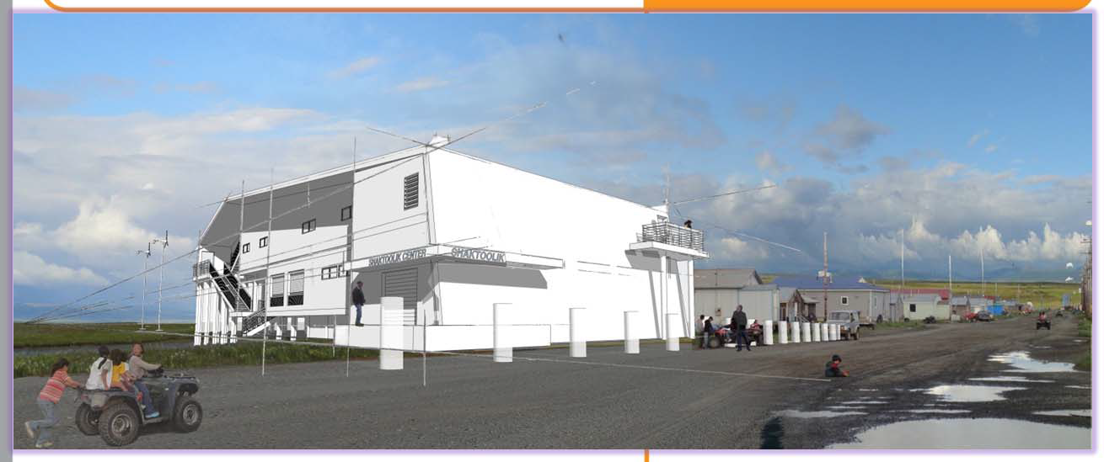
Shaktoolik Evacuation Shelter Design Analysis Report
Shaktoolik hired a contractor to develop a concept-level design for an elevated structure which will provide shelter for the community during emergencies, principally during storm surges, but also in other extreme weather events and serve other non‐emergency functions.

Slide 20
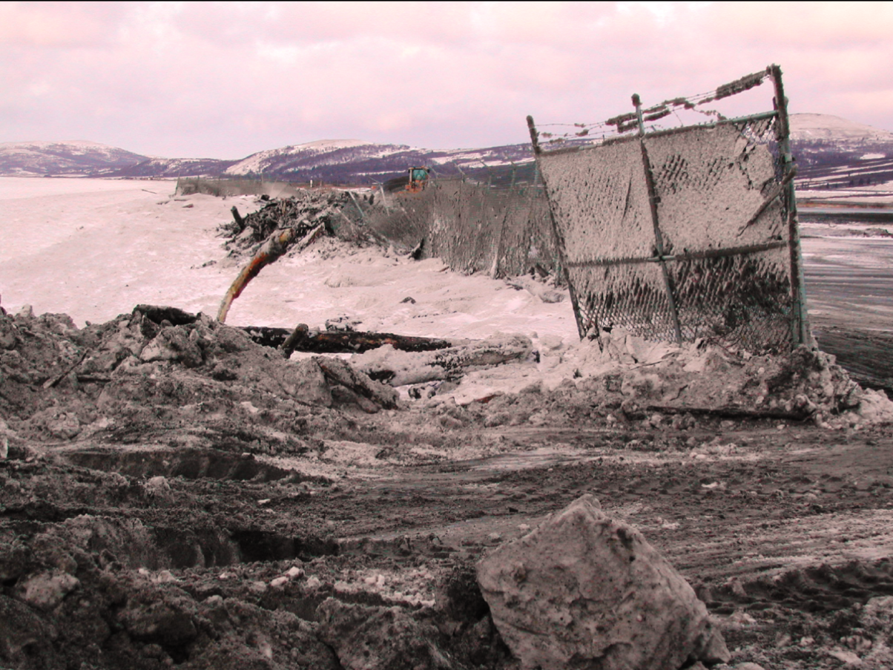
Unalakleet
Community has developable land nearby and can resolve issues by moving infrastructure/facilities away from source of impact
Photo: Steve Ivanoff

Slide 21
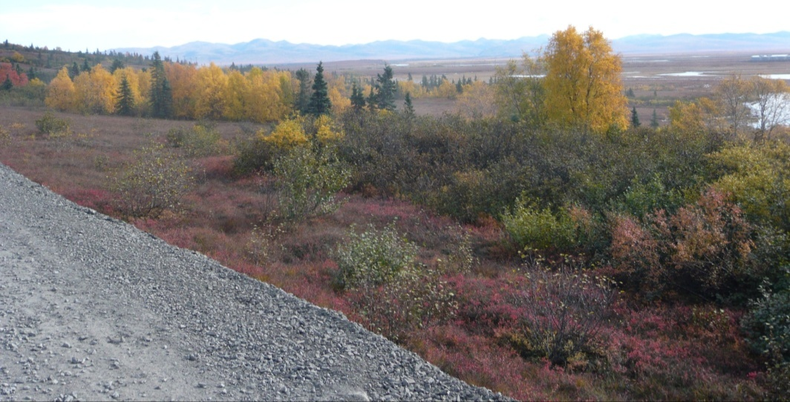
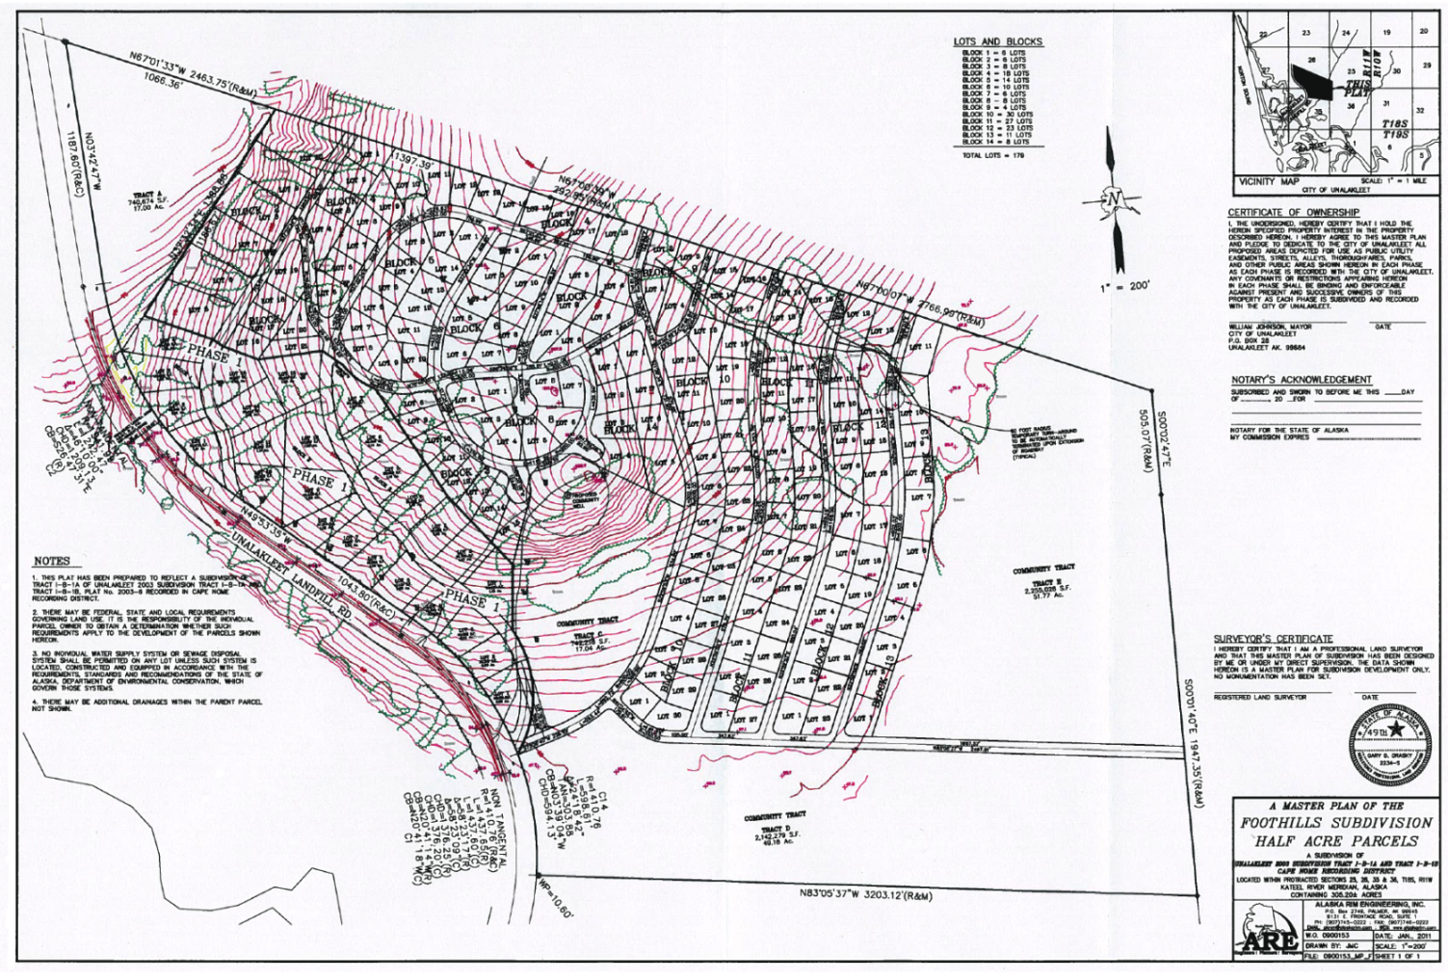
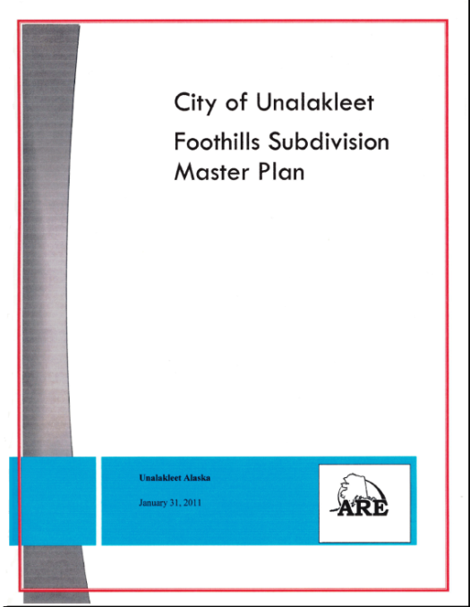
Foothills Master Plan and Subdivision Design Project
Directs new development to higher ground, away from impacts of erosion, flooding, and storm surge.
Photo: Sally Russell Cox

Slide 22
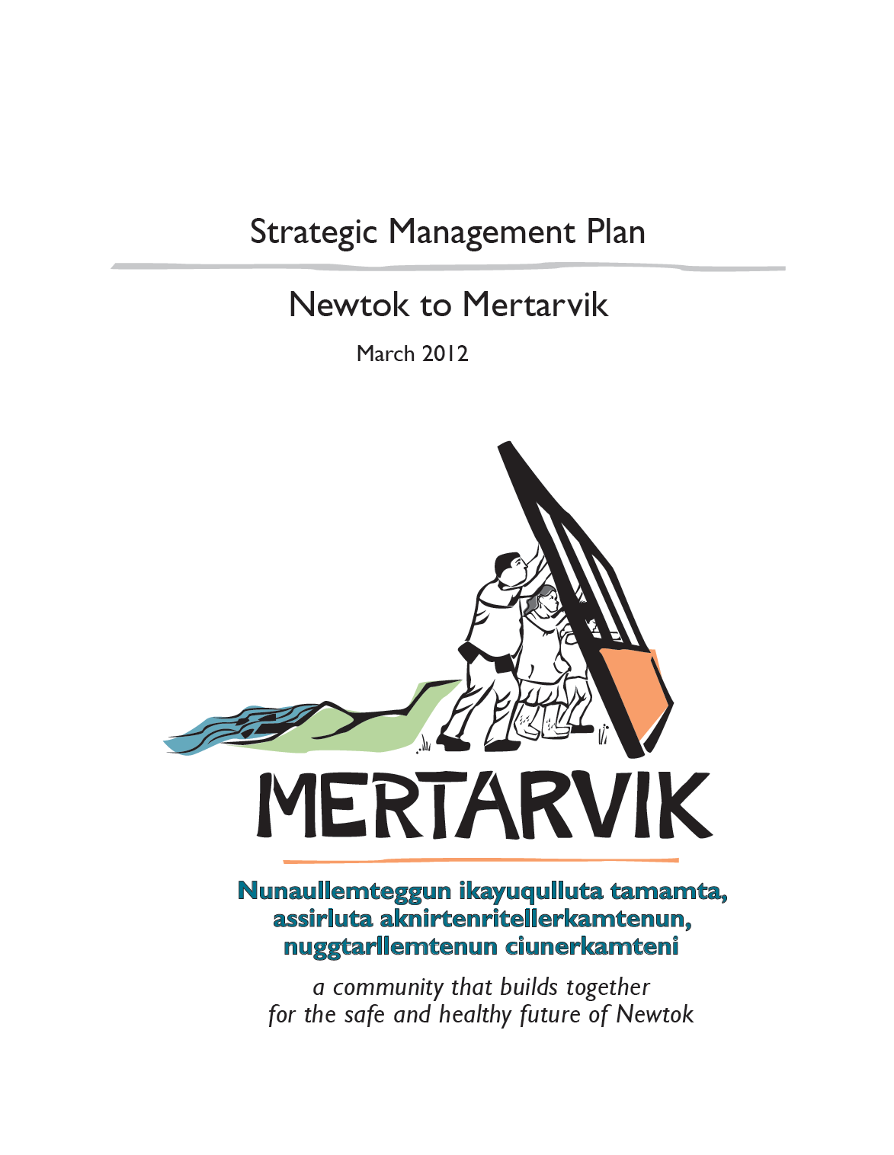
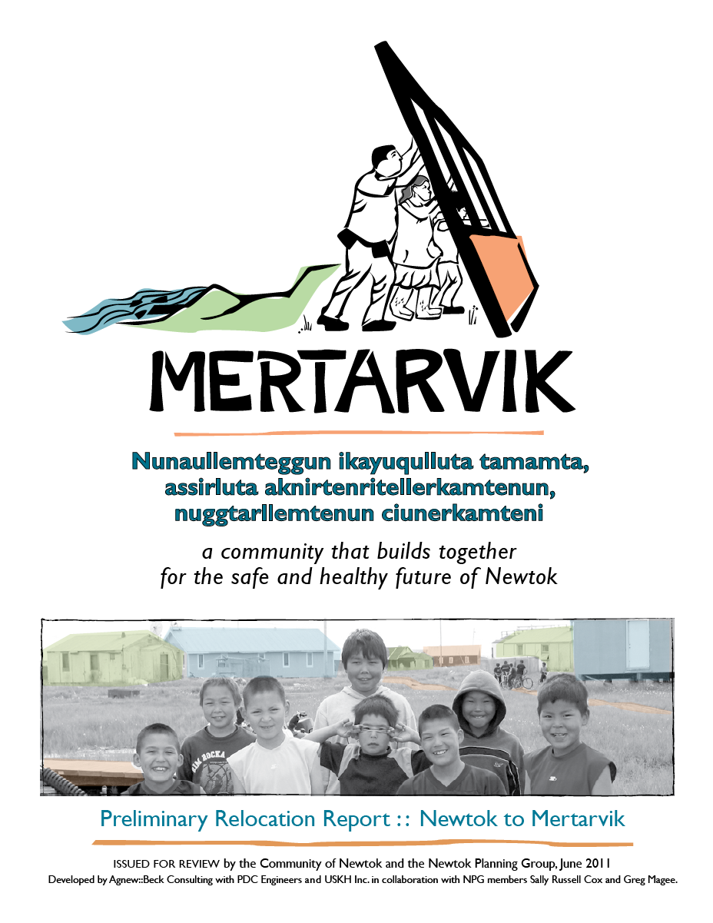
Mertarvik Strategic Management Plan
Sets a common vision for relocating the village of Newtok to relocation site on Nelson Island.
Notes:
DCRA acquired funding through the federal Coastal Impact Assistance Program for a Strategic Management Plan for the Newtok relocation, and in 2011, the Newtok Planning Group began working with a contractor to develop the Strategic Management Plan.

Slide 23
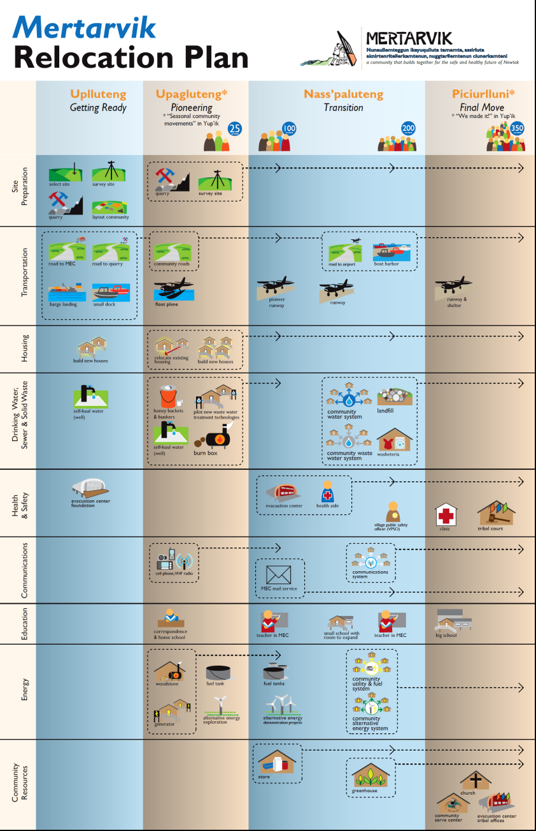
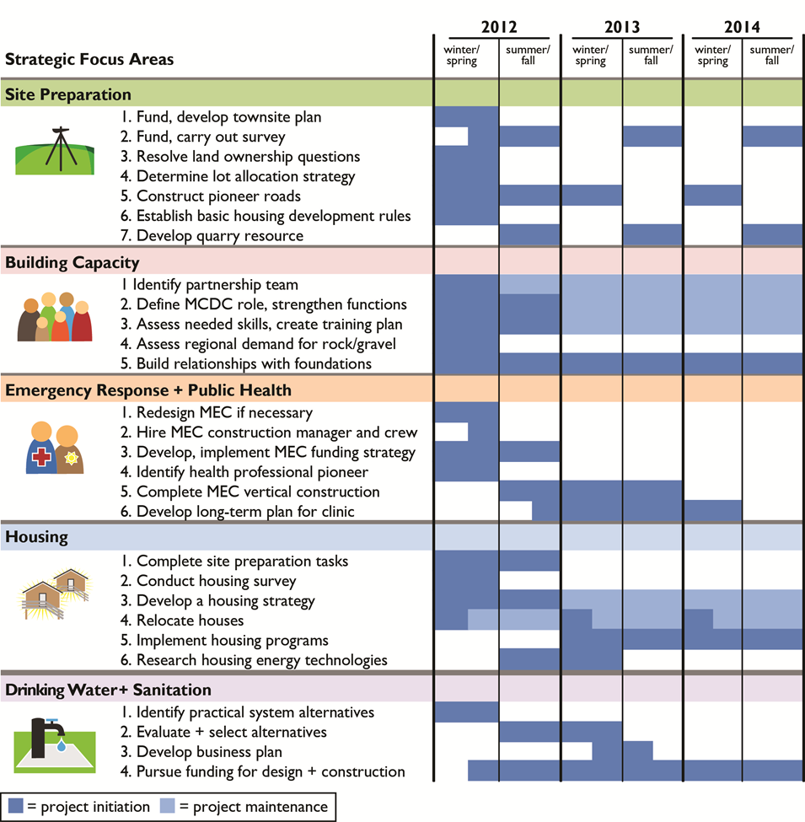
Notes:
DCRA acquired funding through the federal Coastal Impact Assistance Program for a Strategic Management Plan for the Newtok relocation, and in 2011, the Newtok Planning Group began working with a contractor to develop the Strategic Management Plan.

Slide 24
Community Decision-Making Process: Phase 3

Slide 25
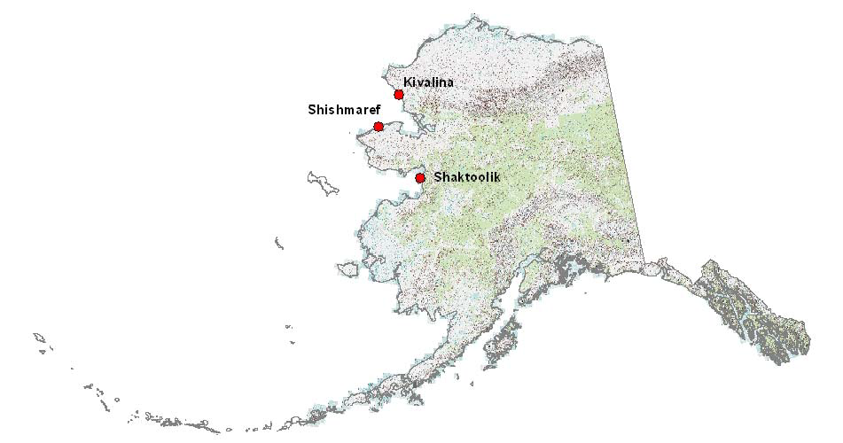
Alaska Community
Coastal Protection Project

Slide 26
Objective:
To increase community resilience to the impacts of natural hazards
Essential Components:
Strong community leadership
Agency support and collaboration
Careful, effective planning
Final Product:
A Strategic Management Plan that provides a “blueprint” for how the community and agencies will work together to increase community resilience and implement adaptation actions over the short-term (0-5 years), mid-term (6-10 years) and long-term (11+ years).

Slide 27
Strong Community Leadership
Community grant for full-time Community Coordinator (2 years) to:
  Represents community at interagency working group meetings
  Works with project staff, inter-agency group, and planning contractor on resiliency plan
  Advocates for funding to carry out resiliency plan
*Funding for other community leaders to attend inter-agency meetings
DCRA provides training, technical assistance and other support to Community Coordinator

Slide 28
Agency Support and Collaboration
Organization of interagency working group (state/federal agencies and regional organizations):
Coordinated assistance to community to identify and achieve resilience actions, based on conventional funding channels of agencies
Benefits include:
leveraging of resources
better coordination of work
reduced conflicts in project timelines and construction windows

Slide 29
Careful, Effective Planning
Comprehensive Strategic Management Plan:
Projected timelines and costs associated with projected tasks or activities
The sequence of tasks and subtasks that must take place
The entities responsible for specific tasks or activities.
The best construction windows to reduce environmental impacts
The resources required
The schedule of activities. Development of a strategic management schedule for activities will be an important product.

Slide 30
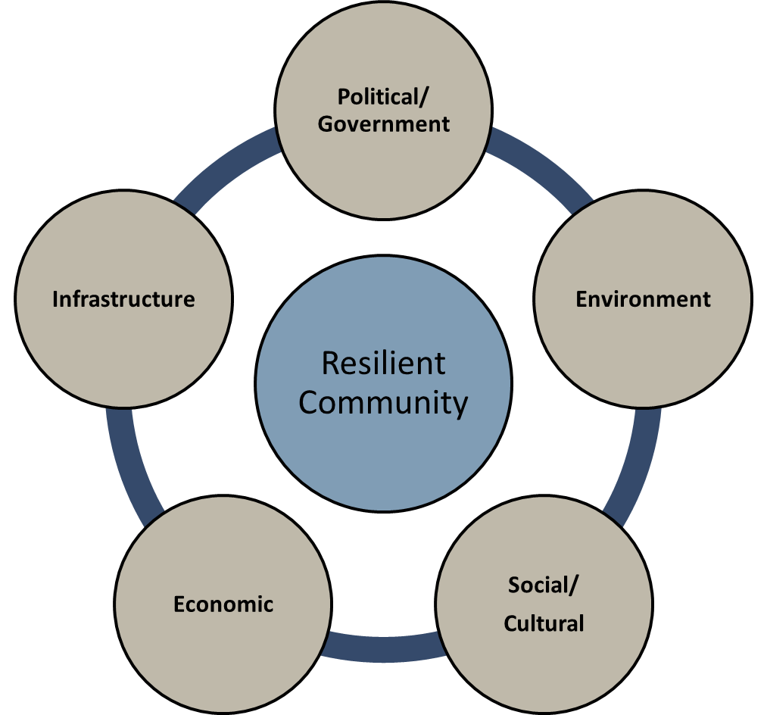

Slide 31
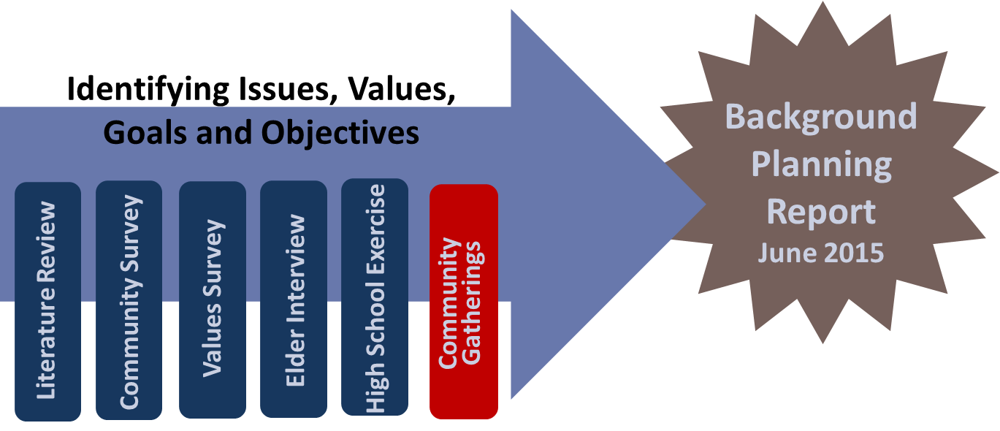
Phase 1
Contains results of
  Interviews and surveys
  Literature review
  Vision statement
  Guiding principles
  Resilience-related issues
A living document
Provides the foundation for the Strategic Management Plan

Slide 32
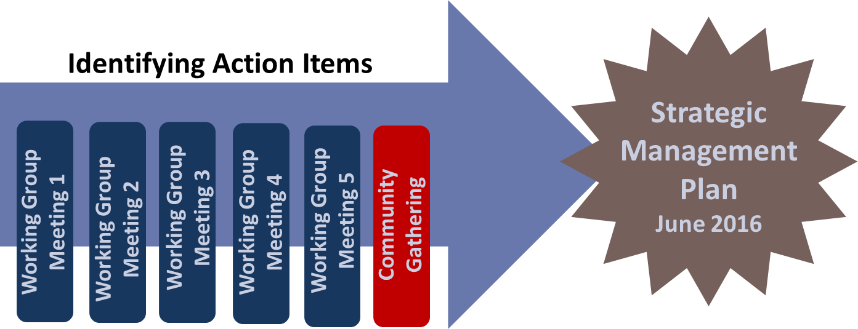
Phase 2
Community Inter-Agency Planning Groups
Planning Team
Community Coordinator
Local leadership from Tribe, City, ANCSA Village Corporation
Regional Organizations
  ANCSA Regional Corporation, Native Non-Profit Regional Organization, Regional Health Organization, Regional Housing Authority …
State Agencies
  DCRA, Village Safe Water, DOT/PF, DHS&EM, Alaska Energy Authority…
Federal Agencies
  Corps of Engineers, FEMA, FAA, HUD, EDA, USAD RD …

Slide 33
Development of Strategic Management Plan

Slide 34
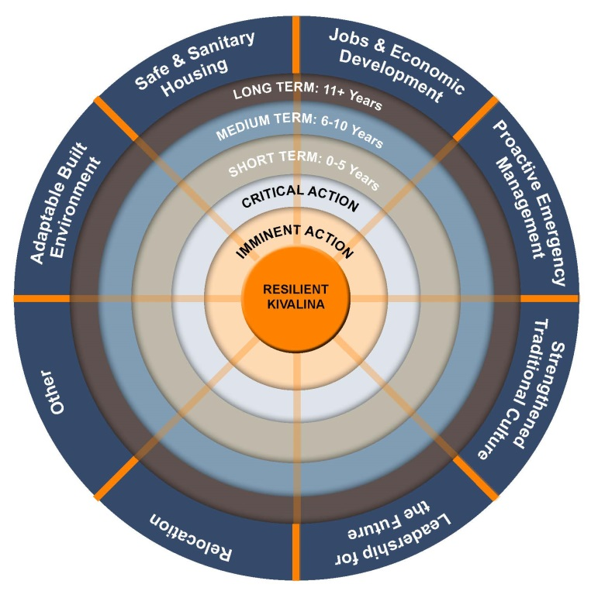

Slide 35
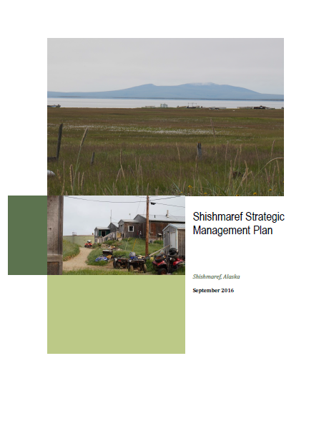
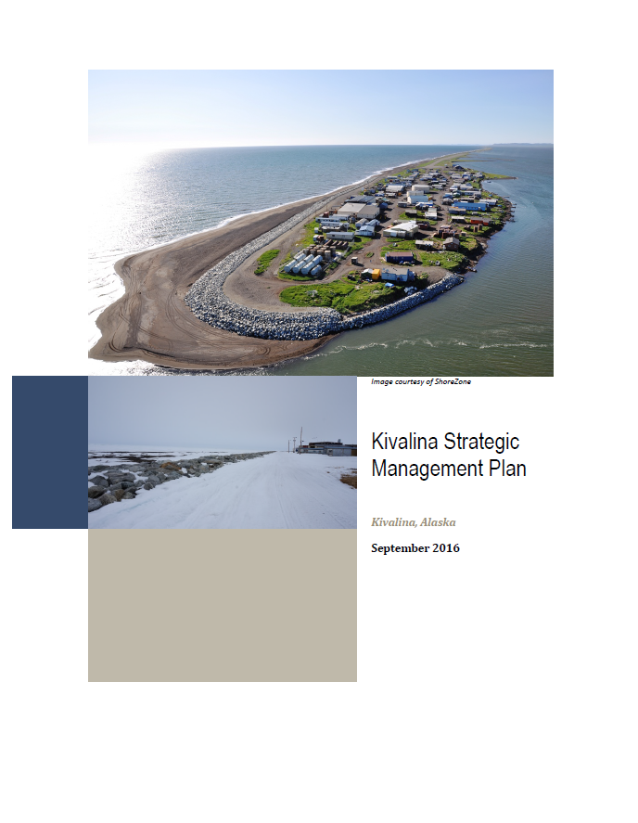
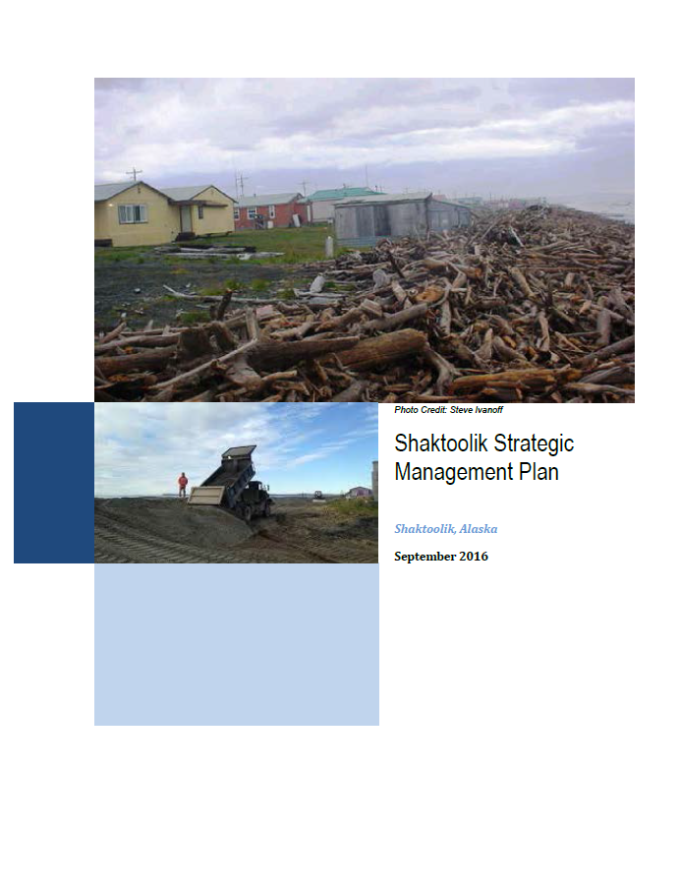
Online at:
https://www.commerce.alaska.gov/web/dcra/PlanningLandManagement/AlaskaCommunityCoastalProtectionProject.aspx

Slide 36
Sally Russell Cox
State of Alaska
Department of Commerce, Community, and Economic Development
Division of Community and Regional Affairs
Email: sally.cox@alaska.gov
Phone: 907.269.4588
Web: http://commerce.state.ak.us/dnn/dcra/PlanningLandManagement/ACCIMP.aspx
http://commerce.state.ak.us/dnn/dcra/PlanningLandManagement/AlaskaCommunityCoastalProtectionProject.aspx
http://commerce.state.ak.us/dnn/dcra/PlanningLandManagement/NewtokPlanningGroup/MertarvikStrategicManagementPlan.aspx

