Slide 1
Department of Commerce, Community and Economic Development
Alcohol & Marijuana Control Office
Petitioning for additional Restaurant/Eating Place Licenses for certain
local governing bodies
Gabriel Gonzales
April 4, 2023

Slide 2
Additional REPL licenses for certain LGBs
Alaska Statute 04.11.405 (a brand new law under Sec. 54, ch. 8, SLA 2022 aka SB9/Title 4 Rewrite) https://www.akleg.gov/PDF/32/Bills/SB0009Z.PDF
(a) A first class city, a home rule city, or a unified municipality may submit a resolution to the board, adopted by its legislative body, petitioning the board for the issuance of additional restaurant or eating place licenses under AS 04.11.100 AS 04.09.210 that exceed the limits under AS 04.11.400(a) in accordance with this section

Slide 3
Additional REPL licenses for certain LGBs
Sec 54, Ch.8, SLA 2002
(b) The board, following a public hearing, may issue one or more additional restaurant or eating place licenses under AS 04.11.100 AS 04.09.210, within the boundaries of the municipality, if the board finds that
  (1) The municipality ...

Slide 4
Additional REPL licenses for certain LGBs
Alaska Statute 04.11.405(b)(1) continued
  (1) The municipality
    (A) serves as a center for commercial activity within and outside the boundaries of the municipality by providing goods and services to a population that is greater than the permanent resident population within the boundaries of the municipality;
    (B) maintains a local law enforcement department
    (C) exercises planning or land-use authority; and...

Slide 5
Additional REPL licenses for certain LGBs
Alaska Statute 04.11.405(b) continued
    (D) at the time of the petition, meets or exceeds the maximum limit under AS 04.11.400(a) for restaurant or eating place licenses issued under AS 04.11.100 AS 04.09.210;
  (2) the board finds; the number of additional licenses does not exceed the number of additional licenses requested by the municipality in the petition; and
  (3) the board finds; granting the additional licenses is in the public interest.

Slide 6
Additional REPL licenses for certain LGBs
Alaska Statute 04.11.405
(c) A resolution submitted by a municipality under (a) of this section must include
  (1) information demonstrating that the petitioner meets the criteria in (b) of this section;
  (2) the most recent estimate of the number of people who claim residency or work outside the boundaries of the municipality and who are served by the municipality, including the...

Slide 7
Additional REPL licenses for certain LGBs
Alaska Statute 04.11.405(c)(2)
    (A) population located outside the boundaries of the municipality that relies on the municipality for goods and services;
    (B) visitor population; and
    (C) nonresident worker population that resides in the municipality, but that is not counted in the latest federal or state census for the municipality.

Slide 8
Additional REPL licenses for certain LGBs
Alaska Statute 04.11.405(c)
  (3) the number of existing restaurant or eating place licenses
    (A) within the boundaries of the municipality;
    (B) in a geographic area that the municipality serves under (2) of this subsection;
  (4) information showing that the number of additional licenses requested does not exceed one license for each 1,500 population of the pop. Identified under (2) of this subsection; and

Slide 9
Additional REPL licenses for certain LGBs
Alaska Statute 04.11.405(c)
  (5) additional justification, as necessary, to demonstrate that granting of the additional licenses is in the public interest.
(d) If the board grants a petition for additional restaurant or eating place licenses under this section to a municipality, the board may not authorize additional REPL licenses to the same municipality under this section for the following year.

Slide 10
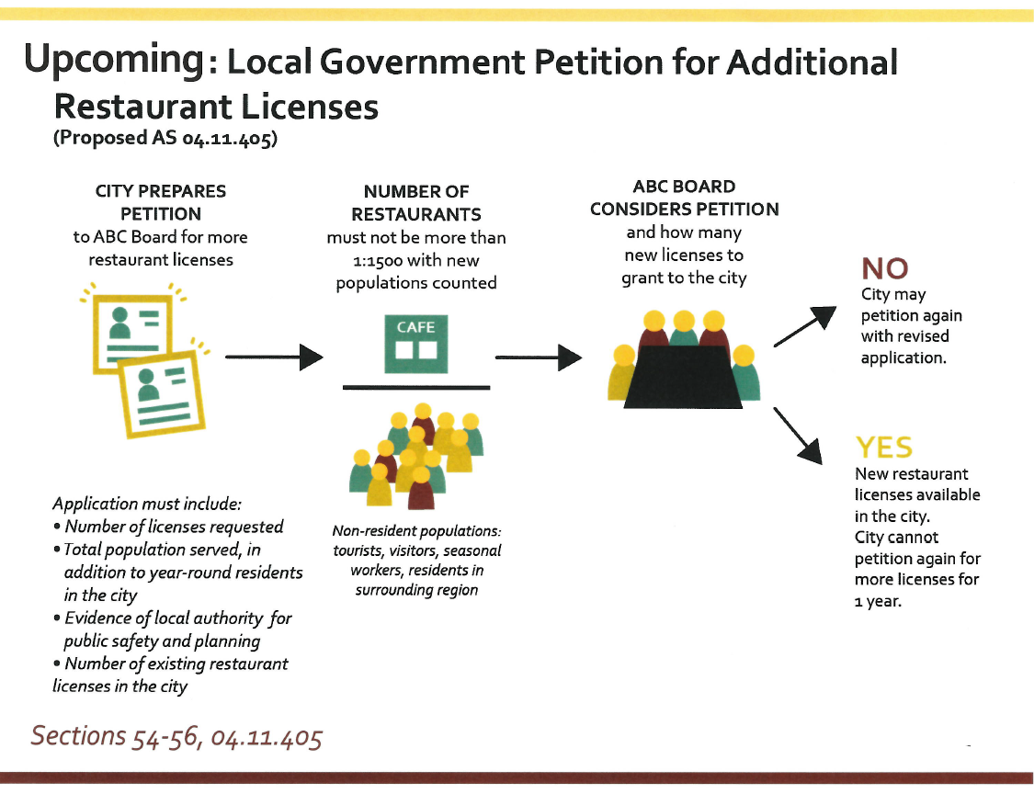
Overview of process

Slide 11
Additional REPL licenses for certain LGBs
Discussion/ Questions?

Slide 12
Alcohol & Marijuana Control Office
  Gabriel Gonzales, Local Government Specialist
  Jane P. Sawyer, Program Coordinator
  Joan M. Wilson, Director
  Contact Information:
  (907) 782-5772
  gabriel.gonzales@alaska.gov

